Slide 1
U.C. Berkeley: Economics 115: Spring 2020
20th Century Economic History: Lecture 19: The Coming of the Near-Second Great Depression: 2001–2009
Brad DeLong
Department of Economics & Blum Center, U.C. Berkeley; & WCEG
delong@econ.berkeley.edu
last revised: 2020-04-20
for delivery: 2020-04-29
<https://bcourses.berkeley.edu/courses/1487684>
<https://github.com/braddelong/public-files/blob/master/econ-115-lecture-19.pptx>
<https://www.icloud.com/keynote/0odd9qfdZ4RJOYfQYiWU2bbpQ>

Slide 2

Final Paper

Slide 3

The Coming of the Near-Second Great Depression: 2001–2009
There was no excuse:
No reason for the world to have been caught so flat-footed by the financial crisis of 2007-8
There had been previous crises:
Mexico in 1994-5,
East Asia in 1997-98,
Russia in 1998
Brazil, Turkey, and Argentina.
All knew that a crisis might have a catastrophic outcome
All saw signs of trouble:
Global current account imbalances
Unusually low interest rates
Bubble-like asset prices
A world becoming increasingly prone to financial turbulence.
Consequences of the neoliberal turn:
Financial markets more lightly regulated
A pronounced distrust of activist governments
A tendency to think that markets were smarter than governments
42:00 minutes of audio
1:15
Notes:
There was no excuse for the world to have been caught so flat-footed by the financial crisis of 2007-8. There had been previous crises in Mexico in 1994-5, East Asia in 1997-98, Russia in 1998, and then in Brazil, Turkey, and Argentina. All knew that a crisis might have a catastrophic outcome—that countries hit by financial crisis often experienced a very sharp and sometimes permanent growth slowdown. And all saw signs of trouble: global current account imbalances, unusually low interest rates, and bubble-like asset prices seemed to indicate a world that was becoming increasingly prone to financial turbulence.
Yet one consequence of the neoliberal turn was that financial markets were more lightly regulated than they had been in the past. Another was a pronounced distrust of activist governments—especially those that took preemptive action when some might doubt its necessity. And the third was a tendency to think that markets were smarter than governments. All three of these consequences, in the context of the mid-2000s, stored up immense trouble.

Slide 4
Say’s Law and Say’s Recantation
Does supply—the decision to produce—create its own demand?
Jean-Baptiste Say had claimed back in 1803 that there was no such thing as a “general glut”
There can be excess supply for one commodity
But it was automatically and necessarily excess demand for another.
Workers needed to get “on y’r bike!”
As British conservative politician Norman Tebbitt said in 1981
And move over to the sectors where there was excess demand.
John Stuart Mill in 1829:
There could too be a “general glut”.
An excess demand for cash was an excess supply of everything else—including labor
With an unsatisfied demand for cash, you can either (a) work more and so buy cash, or (b) spend less:
With an excess demand for something else, you have to buy cash
This asymmetry makes cash special
There are three ways in which an excess demand for cash can emerge
1:30
Notes:
Back up: Recall French economist Jean-Baptiste Say had claimed back in 1803 that there was no such thing as a “general glut”: an economic depression. Excess supply on the market of some commodity, he claimed, was automatically and necessarily excess demand for another. What was claimed to be a general depression was merely an imbalance in supply—and workers needed to get on their bikes, as British conservative politician Norman Tebbitt said in 1981, and move over to the sectors where there was excess demand. Recall that British economist John Stuart Mill parried in 1829 that there could too be a “general glut”. An excess demand for cash was an excess supply of everything else—including labor. Why? Because if you have an unsatisfied demand for, say, yoga lessons, the only way to satisfy that demand is to go out and work more and use what you earn to buy yoga lessons. But if you have an unsatisfied demand for cash, you can either (a) work more, or (b) spend less buying other things. And recall that back in 1829 Say agreed with Mill: there could be a “general glut”, if something, like a financial crisis, caused workers, businesses, and financiers to demand to hold more cash and caused banks to refuse to extend credit and create deposits as far.
Now let us note that there are three ways in which an excess demand for cash can emerge:

Slide 5
A Monetarist Depression
A fall in the money stock (or a rise in money demand)
Excess demand for cash
To raise cash:
People cut back on spending
People sell interest-bearing assets
Everything has to add up!
Prices of interest-bearing assets fall
Interest rates on interest-bearing assets rise
High unemployment and high interest rates
1:45
Notes:
22.1.2. A Monetarist Depression
One way that an excess demand for cash can emerge is if something happens to reduce the economy’s money stock—the amount of cash, plus other assets (like bank account balances reflecting previous deposits in, or lines of credit extended by banks) used as means of payment; or if something happens to raise demand for cash and other means-of-payment assets. Those who seek to hold more cash (and other means-of-payment assets) then try to sell the interest-paying assets they hold in order to raise cash.
But in the economy as a whole, everything has to add up: one person can sell an interest-paying asset only if someone else buys it. So in the aggregate these sales do not repair the imbalance—they do not shrink the supply of interest-bearing assets and increase the supply of cash—they only lower the price and raise the interest rates on interest-paying assets. That is how you can tell if you are in a monetarist depression: unemployment will be high, and interest rates will be high too.
A monetarist depression has a natural cure: (a) the government needs to print cash or get banks to make loans and extend credit and so increase deposits (and other means-of-payment assets); or (b) “confidence” has to be restored so that the demand for cash shrinks back to normal. In the standard IS-LM graph framework set out by economist John Hicks back in 1937, the problem is that the LM curve is shifted too far to the left, and needs to be pushed to the right, by restored confidence or monetary expansion.

Slide 6
A Keynesian Depression
A fall in the stock of savings vehicles for transferring wealth into the future
Interest rates fall
Cash then looks like an attractive savings vehicle
Cash pushed into service as “speculative” balances
“Transaction” balances are scarce
Best cure: government borrows money and uses it to buy stuff:
Borrowing money creates more savings vehicles
Those push cash back into its transactions-balance role
Buying stuff puts people to work directly
Also: restore confidence so business creates more savings vehicles
2:15
Notes:
22.1.3. A Keynesian Depression
A second way that an excess demand for cash can emerge is if something happens to reduce the economy’s stock of savings vehicles—assets, interest-paying or capital gains-yielding, that people use to transfer purchasing power forward in time from the present to the future. If the economy is short of savings vehicles, they will sell for a high price—the interest rate on them will be low. As interest rates fall, however, cash begins to look like an attractive savings vehicle: it does not pay interest, but holding it is a good and safe way (in the absence of inflation) to move purchasing power forward in time from the present to the future. As cash is pressed into service as a savings vehicle, demand for it goes up—and the excess demand for cash that produces the downturn and high unemployment emerges.
You can tell that you are in a Keynesian depression when unemployment is high, but when interest rates are not also high, but rather very low. A Keynesian depression has a different cure. Yes, restoring “confidence” can work—but it works largely by inducing businesses to invest more in boosting their capital stocks, and in the process of so doing finance their capital investment by issuing more stock and bonds, and so increasing the supply of savings vehicles in the economy. But there is a more direct way: the government is a fine creator of savings vehicles in the form of its debt, so it can issue bonds that people will buy, thus pushing some of the cash drafted into being a substitute savings vehicle out of that role, and use the purchasing power to put people to work directly by paying them to make useful stuff.
Note that the standard monetarist cure—having the central bank expand the money stock by buying bonds for cash—will not work: yes, the supply of cash will go up, but the private market’s demand for cash will go up as well, as the reduction in bonds out there in the market will raise the quantity of cash pressed into service as savings vehicles by as much as the quantity of cash increases. In the standard IS-LM graph framework set out by economist John Hicks back in 1937, the problem is that the IS curve is shifted too far to the left, and needs to be pushed to the right, by restored confidence or fiscal expansion.

Slide 7
A Minskyite Depression
What we saw in 2008-10:
Interest rates are not all high
Interest rates are not all low
The world is short of safe assets
The government has to create safe assets:
Buy risky assets
Guarantee risky assets
Worry about cracking its own status as provider of safe assets
The Bagehot-Minsky Rule:
lend freely (in order to expand the safe-asset supply)
on collateral that is good in normal times (accepting that those whom it is thus subsidizing are getting a very good deal, since times are definitely not normal)
but do so at a penalty rate (so that the amount by which financiers, especially financiers whose previous imprudence has created the confidence crash and the safe asset shortage, profit is distinctly limited).
4:00
Notes:
Then there is a third type of depression: the kind we saw in 2008-10. Unemployment rose very high. But interest rates are not all high, and they were not all low. Interest rates on safe assets—like U.S., German, and Japanese bonds—reached unbelievably and astonishingly low levels. But interest rates on risky bonds were not low: they were, instead high, and sometimes very very high indeed. The world was not short of cash: central banks flooded the zone with cash. The world was not short of savings vehicles in general: you could buy risky savings vehicles—private debt that was not AAA-rated, and the stocks of companies that faced some market and growth risk—for an absolute song. What the world was short of was of safe assets.
The private sector cannot then create safe assets: if it could, then it would already have done so, since the shortage means that safe assets can be sold at a very high price. So the government has to step in. The central bank can take risk off of the private sector’s and onto its own balance sheet by buying up not short-term safe government bonds but long-term risky assets for safe cash, thus increasing the supply of safe assets, while reducing the risk borne by the private sector and freeing up that risk appetite for deployment elsewhere. The problem is that this “quantitative easing” would need to be done on an enormous scale to be effective. The government can—as long as the government’s debt is perceived as a safe asset—raise the supply of safe assets by issuing bonds that people will buy, and use the purchasing power to put people to work directly by paying them to make useful stuff. But will doing so crack the government’s status as a provider of safe assets? In 1931 the government of Austria tried this trick when it took over the debt of the unsafe Credit-Anstalt bank, and found that it had made the problem worse, as so doing had made people lose confidence in its own debt, which had previously been seen as safe. And this, too, needs to be undertaken at immense scale to be effective.
Or the government can offer loan guarantees and asset swaps, and by so doing transform savings vehicles regarded as unsafe into safe assets. This is by far the cheapest and most effective. But it requires that the government have the expertise to price its loan guarantees and swaps effectively: if it prices them too high, no one takes them up and the economy crashes; if it prices them too low, financiers take the government—and the public—to the cleaners. This approach has been formalized in the Bagehot-Minsky rule: in such a crisis—with a safe-asset shortage and a rapidly approaching depression—the government needs to lend freely (in order to expand the safe-asset supply) on collateral that is good in normal times (accepting that those whom it is thus subsidizing are getting a very good deal, since times are definitely not normal) but do so at a penalty rate (so that the amount by which financiers, especially financiers whose previous imprudence has created the confidence crash and the safe asset shortage, profit is distinctly limited).
One problem with this Bagehot-Minsky rule is that it treats unequals equally: those who have been financially imprudent and bear some responsibility for the crisis get bailed out along with those whose only fault was getting caught in the unexpected financial whirlwind. A second problem is that it requires skill, good judgment, and luck to carry out. A government without confidence in its own technocratic chops, or that fears a political backlash from bailing out too many perceived as unworthy, may decide to give up on following some or all of the Bagehot-Minsky rule. In that case, its policy is reduced to attempting to use sorcery to summon the confidence fairy to rescue the economy.
In 2008 first the United States and then the North Atlantic suffered a Minsky depression.

Slide 8
No Reason for a Depression
Many argue an unavoidable result of the housing bubble of 2003-6:
They are wrong
There was a housing bubble
But housing bubble unwound by 2008
Leaving $500 billion of bad debt
But that is not enough to bring down the economy
Federal Reserve badly mishandled the situation
2:30
Notes:
The 2007-8 financial crisis and subsequent recession left the Global North 10% poorer than it otherwise would have been. There are many who argue that this business-cycle catastrophe was an unavoidable result of the housing bubble in the United States. Many still claim that the bubble’s deflation triggered the financial crisis. But that is not true. The bubble had already deflated substantially before the crisis erupted.
Recall that by mid-2008, home prices had returned to, or even fallen below, levels supported by their underlying fundamentals, and employment and production in the residential construction industry had declined to levels far below trend. The work of rebalancing asset valuations and reallocating economic resources across sectors had already been accomplished. To be sure, there still would have been around $500 billion worth of financial-asset losses in the form of defaults on subprime mortgages and home-equity loans. But that is only one-quarter of the relative share what global equity markets lost in seven hours on October 19, 1987. In should not have been enough to sink the global financial system. Indeed, Ben Bernanke, then Chair of the US Federal Reserve, seemed confident in the summer of 2008 that the correction in housing prices had not triggered any unmanageable financial crisis. At the time, he was mainly focused on the dangers of rising inflation.
And then the bottom fell out because beliefs changed. Investors came to believe that financial markets were saddled with highly elevated risk. This led to the sudden run on both the shadow and non-shadow banking systems, as investors scrambled to dump assets. The increased risk that they had imputed to the system became a reality. Like triage nurses in an emergency room, they quickly assessed the patient and then ran with their initial diagnosis as if there were no other option.
Nothing about the fallout from the crisis was inevitable. Had the Fed been in possession of contingency plans for putting too-big-to-fail institutions into receivership and becoming the risk-bearer of last resort, we would be living in a very different world today. Chance, contingency, and policy error played the decisive role in the crisis and its aftermath.
Yet there is a logic. Such crises of belief are manifestations of a chronic condition that must be managed. The seeds of the next Kindlebergian sequence – displacement, optimism, enthusiasm, crash, panic, revulsion, discredit – have already been sown by the very policies that were needed to address the last downturn.

Slide 9
The Global Savings Glut of 2003-8
Rise of Asia and rise of saving; fall of high tech and fall in investment:
Asian trade surpluses
Some way needed to be found to boost the amount of bonds being newly issued by businesses:
and so satisfy the excess worldwide demand for savings vehicles
Flood the world with liquidity
Low interest rates and a housing boom
Housing prices rose much more than fundamentals
3:30

Slide 10
Financial Engineering and the Housing Bubble
Government programs that provide subsidies played essentially no role:
It was not FNMA but rather privates like Countrywide the talent subprime
The claim that the Federal Reserve did it is incoherent
It was an absence of safety and soundness regulation that did it
Soft hearts for rich mortgage speculators hoping to evade regulation
Bubbles gonna bubble
Yet the bubble deflated and housing construction rebalanced without crisis—until late 2007
5:15
Notes:
So the next stage in our study of the origins of the downturn is to look at mortgage finance and financial engineering in the 2000s.
22.2.2. Mortgage Finance and Financial Engineering in America
22.2.2.1. Securitization and the Concealment of Risk
By now the litany is familiar: the old model of banking, in which banks held on to the loans they made, was replaced by the new practice of originate-and-distribute. Mortgage originators—which in many cases had no traditional banking business—made loans to buy houses, then quickly sold those loans off to other firms. These firms then repackaged those loans by pooling them, then selling shares of these pools of securities; and rating agencies were willing to label the resulting product chicken—that is, to bestow their seal of approval, the AAA rating, on the more senior of these securities, those that had first claim on interest and principal repayment. And everyone ignored both the risks posed by a general housing bust and the degradation of underwriting standards as the bubble inflated. When the bust came, much of that AAA paper turned out to be worth just pennies on the dollar.
The usual way this story is told conveys the impression that Wall Street had no incentive to worry about the risks of subprime lending, because it was able to unload the toxic waste on unsuspecting investors throughout the world. But this claim appears to be wrong: while there were plenty of naive investors buying complex securities without understanding the risks, the Wall Street firms issuing these securities kept the riskiest assets on their own books. And they also bought risky assets issued by other financial institutions. And Europe managed to inflate similar giant housing bubbles without turning to American-style complex financial schemes. There was securitization; there was concealment of risk; there was much more irrational exuberance.
22.2.2.2. The Housing Bubble
Between 1997 and 2007, all throughout the North Atlantic, real estate prices soared. The prices of housing more than doubled in the British isles, nearly doubled in Spain, and rose by 75 percent in the United States.
You may hear that there were also government programs that provided subsidies to mortgage lenders and borrowers. But this played net to no role at all in the runup of prices. The public subsidies enterprise mortgage lenders like the Federal National Mortgage Administration—FNMA—“Fannie Mae”—had existed long before the 2000s. You could attribute a runup in housing prices in the 1940s and in the 1950s to their appearance and existence. But you could not so attribute a runup in housing prices in the 2000s. The lending that allowed the purchase of houses at rising prices was primarily made not by government-sponsored enterprises like Fannie Mae but by private specialized mortgage lenders like the infamously-bankrupt Countrywide.
You may also hear that there was a Federal Reserve that cut interest rates too far. The logic here is equally dodgy. The Federal Reserve did reduce the overnight rate on loans between banks from 6.5% per year in 2000 to 1% per year in 2003. But western Europe’s central bank, the ECB, reduced interest rates by only half as much as did America’s Federal Reserve—yet Europe’s housing bubbles were if anything larger than those in the United States. Moreover, suppose that the Federal Reserve does reduce interest rates by 3% per year too much, keeps them low for three years, and that all of that reduction gets passed through to mortgage borrowers. That break on interest rates means only that borrowers can afford to pay an extra 9% to buy their house. That is an order of magnitude too small to account for any significant part of the housing price runup.
Was U.S. government policy at fault at all? Yes, but not because the Federal Reserve’s cutting interest rates boosted prices or because the government encouraged Fannie and its cousins to lend into the housing bubble. Financial regulators failed to use their authority to stop excessive risk-taking. As Paul Krugman and Robin Wells write: “conservatives would like to put soft-hearted politicians at the center of this story, they don’t belong there.” But in a sense they do belong there—only their soft hearts weren’t bleeding for working-class Americans hoping to buy houses, but for very rich mortgage speculators hoping to evade regulation and leverage up their large portfolios:
The bubble got started largely thanks to the global savings glut, but that it developed a momentum of its own—which is what bubbles do. Financial innovations such as the securitization of mortgages may have made it easier for the bubble to inflate—but European banks managed to extend too much credit without such frills. However, it is clear that there were major failures in oversight, in both Europe and America. And the bubble reached its peak in 2005.
At that moment concern about financial stability shifted from America’s enormous trade deficit to its surging property markets and real-estate bubble. Could an obviously overheating market be cooled without sending America, and its main trading partners around the world, into an economic tailspin?
Yet the American housing bubble deflated without trouble. By mid-2007, housing prices appeared well on their way back to sustainability. That had been accomplished without a recession. And there was good reason to think that the United States had escaped trouble.

Slide 11
The Housing Crash
When bubbles burst, wealth disappears
Is this wealth leveraged?
If not, no biggie—cf. dot-com crash
But this wealth was leveraged
Policymakers looking in the wrong direction
Don Kohn gets nervous: ‘we should not hold the economy hostage to teach a small segment of the population a lesson’
Worry about the safety and soundness of money-center banks:
Bankruptcy of Bear Stearns
Bankruptcy of Lehman Brothers
3:45
Notes:
22.2.2.3. The Housing Crash
What happens when bubbles burst? Invariably, a lot of paper wealth disappears. But that, in itself, isn’t enough to turn a burst bubble into a catastrophe for the economy as a whole. The stock crash of 2000–2002 was a $5 trillion hit to US household wealth. It created a lot of pain for people counting on capital gains for their retirement, but it didn’t trigger any broader systemic crisis. The housing bust was an $8 trillion hit—not all that much bigger than the stock crash, once one takes into account both inflation and economic growth in the interim. But it produced the worst global crisis since the 1930s. Why?
One answer is that policymakers were looking in the wrong direction. It became clear in the second half of 2007 that there was potential trouble, not so much because the housing bubble had largely collapsed, but because too many financiers had made too leveraged bets on a continued boom in housing prices. The Federal Reserve reacted by standing ready to provide liquidity at normal market rates to institutions that found themselves momentarily embarrassed by illiquid counterparties. But it showed little willingness to take broader action—to substantially ease monetary conditions, or begin acting as a lender-of-last resort. The fear was that responding to trouble caused by imprudent lending would provide a safety net—a “Bernanke put” on asset prices. That would encourage more imprudent lending in the future.
But by the end of the year it was no longer clear that was appropriate. Federal Reserve Vice Chair Don Kohn was among those nervous first: “we should not hold the economy hostage to teach a small segment of the population a lesson”, he warned in late 2007. But his view was distinctly a minority one back then, and remained a minority view until it was too late.
There are two main answers to the question of why some asset bubbles do so much damage when they burst. The narrow answer focuses on the financial sector; the broad answer argues that debt and leverage among nonfinancial players such as corporations and home owners are equally important.
The global real estate bust of 2005-2008, unlike the bursting of the dot-com bubble, raised justifiable concerns about the soundness of banks. Financial institutions, by and large, weren’t exposed to technology stocks. They were, however, very much exposed to losses from mortgage defaults. But how could an old-fashioned panic happen in the modern world? Generations of economics instructors had told students that bank runs—like the famous scene in the movie “It’s a Wonderful Life”—were a thing of the past. In the United States, conventional banking was increasingly supplanted by a variety of alternatives, these days usually grouped together as “shadow banking”, that were not properly regulated and were not properly supported by deposit-insurance and established lender-of-last-resort channels. Investors began parking their money not in bank deposits but in “repo” (repurchase) agreements—very short-term loans to hedge funds and investment banks. Repo yielded higher interest rates, but their owners needed to be sure to sell first or else they would not get their money back if their debtor ran into trouble. Runs on repo brought down the investment banks of Bear Stearns and Lehman Brothers.
In Europe, the breakdown of the traditional banking safety net took a somewhat different form. Banks in the bubble areas of Spain, Ireland, Iceland, and the UK made loans that far exceeded their deposits, which they supplemented by borrowing from other banks and investors. This extra funding could and did dry up. And these European banks were backed by their national governments, not by the European Central Bank—which meant that when really major banking problems arose in some countries, the ability of those nations’ governments to backstop their banks came into question.

Slide 12
Panic and Depression
The nadir came in 2008-9
The fundamental problem was not large:
A $500 billion financial asset loss
The dot-com crash had been a $3 trillion financial asset loss
$500 billion loss hidden
Hence dump any asset possibly connected to be safe
A financial accelerator of 40:
$500 billion of “fundamental” losses
Knocks $20 trillion off of global asset values
2:00
Notes:
22.3. Panic and Depression
Thus the real estate bust created a crisis of confidence in much of the world’s financial system, and eventually paralyzed crucial parts of that system. Signs of strain began appearing in the late summer of 2007; all hell broke loose after the failure of Lehman in September 2008. During the winter of 2008–2009 borrowing costs for almost everyone except governments soared, if they could get credit at all. And the world economy looked dangerously close to a complete meltdown.
22.3.1. The “Fundamental” Problem Was Not Large
This teetering-on-the-edge of a Great Depression-sized macroeconomic catastrophe came as a surprise to me. Nine months earlier, in March 2008, I had reasoned that the problem was not large, and that the risks were very manageable. Consider:
• There were 5 million houses that should not have been built in the desert between Los Angeles and Albuquerque.
• There was $100,000 in mortgage debt on the average overbuilt house that would not be paid, and that has to be eaten by somebody
• Hence there was a $500 billion financial loss from the housing crash that holders of financial securities would have to bear, one way or another
• But the dot-com crash has been a $3 trillion financial loss
• And the dot-com crash pushed the unemployment rate up by only 1½%
• Hence the financial crisis was unlikely to have large effects on the economy.
But the market reasoned differently. The market reasoned:
• There were $500B in losses that we know of
• And all the trained professionals who assured us that these were safe
• Lied, or
• Did not understand the world
• Therefore we need to dump our risky assets—at any price—and buy safer ones—at any price
And as investors dumped assets they had thought were safe but turned out to be risky, it turned out that there was then a very limited supply of truly safe assets. And urgency to sell in panic greatly increased the risk of holding on to the risky assets that were held. The result was a financial accelerator of 40: a $500 billion destruction of wealth via badly thought-out investments building houses brought the total value of global financial wealth down by forty times as much, from $80 trillion to $60 trillion.

Slide 13
Citigroup
Not understanding its derivatives book
Jan 07: $42B safe MBS
Apr 07: $20B safe MBS (plus an additional $38B supersafe)
Jul 07: $13B safe MBS (plus an additional $33B supersafe)
Sep 07: $100M haircut on safe MBS
Oct 07: $1.6B haircut on safe MBS (but no losses on additional $43B)
Nov 07: $10B haircut on $55B of MBS
At the nadir, $55B down to $14B
2:00
Notes:
We can see the process of recognition that assets regarded by safe are not safe at all in the internal discussions and judgments at the then-largest bank in the world—Citigroup—as it tried to understand its holdings of mortgage-backed securities in 2007. The SEC vs. Citigroup civil court case settled in 2010 gives us a window into this process of recognition: that assets widely regarded as safe were in fact not so.
Tracking the documents, it seems clear that in January 2007 the top management of Citi thought that it owned $26 billion of safe MBS. By April 2007, the top managers thought that Citi had reduced its asset holdings to about $20 billion of relatively-safe MBS, and recognized that there was an additional $38 billion on its books—but was confident that that $38 billion were absolutely and totally safe, so that there was no calculable possibility of any loss that needed to be taken into account in any planning scenario. And by July 2007 Citi’s top managers thought that they had reduced their relatively-safe holdings to $13 billion, and their absolutely safe exposure to an additional $33 billion.
Then in the late summer and fall they changed their mind.
In September 2007, Citi concluded that it has probably lost $100 million on its $13 billion of relatively-safe MBS. By October, Citi believed that it has lost $1.6 billion on its $13 billion of relatively-safe MBS—but that it had no losses on what is now seen as an additional $43 billion of exposure.
And then in November 2007 Citi concludes that it has lost $10 billion on its $55 billion of MBS—and that none of them were safe assets at all.
Citi ultimately lost about ¾ of the $55 billion that at the start of 2007 it had thought were safe places to park its wealth.

Slide 14
Where Did the Regulators Go?
Those who can gamble with the government’s money need to be tightly regulated:
Lots of people to blame
Clinton for financial liberalization
Clinton for non-regulation
Alan Greenspan for ducking out of the line of fire
The George W. Bush administration
2:00
Notes:
22.3.2. Where Had the Regulators Been?
Milton Friedman had written in his Program for Monetary Stability that (a) if you promise your depositors/creditors that they can get their money quickly, and (b) if you also promise your depositors/creditors that their money is safe, and (c) if there is any chance at all that this promises create “systemic risk”, then (d) you need to be tightly regulated—regulated so tightly that the only assets you can invest in are U.S. Treasury bonds or things of similar safety. John Maynard Keynes had written in his General Theory of Employment, Interest, and Money that “perhaps all investments should be long-term and indissoluble—like a marriage...” He had written this precisely because he, like Milton, feared a panicked flight to safety, and the collapse of risky asset prices that such a panicked flight to safety would produce.
There are lots of people to blame. You can blame the Clinton administration for acquiescing in Senate Banking Committee Chair Phil Gramm’s desire to repeal Great Depression-era laws separating government-guaranteed commercial banks from other investment banks. (However, the biggest failures and near failures took place in organizations that did not mix commercil and investment banking: Lehmann, Bear Stearns, AIG). You can blame the Clinton administration for deciding not to regulate financial derivatives. You can blame the Federal Reserve for thinking that there was value in exploring new models of providing credit. And you can blame its chair, Alan Greenspan, for asking himself “who am I to tell lenders who want to lend that they cannot lend to borrowers who want to borrow?” and answering “I am nobody”—thus greatly underestimating the seriousness of the situation. You can blame the George W. Bush administration for not just dipping its toe into the waters of financial deregulation but engaging in an ideological crusade for deregulation, on the grounds that it is the people on Wall Street whose personal fortunes are at risk who are much better at assessing and managing risks than the government.

Slide 15
Depression
Unemployment rose to a peak of 10% by late 2009:
Federal Reserve very late to act
Worried about inflation???
China responded appropriately with fiscal expansion
The U.S. and Europe did not
No worry about mobilizing risk-bearing capacity
No desire to get “ahead of the curve”
2:45
Notes:
22.3.3. Depression
And so spending and employment collapsed. And the U.S. unemployment rate rose to a peak of 10% in late 2009.
It should not have risen so high. By early 2008 it was clear that the world and the American economy were in recession—although professional Republicans eagerly disputed that in the oped pages and on TV, hoping to make their bones and win influence and office. But it was not yet foredoomed that the recession would be substantial. Governments should have played it safe. It was most imprudent to assume that things would not get worse. Yet that is what governments and central banks did.
Yes, fiscal prudence is important in the long term. But a financial crisis is not the time for long-term thinking. And it was clear that there was a financial crisis. Governments should have boosted purchases and let the short-run deficit go where it needed to be to preserve full employment. China did so—indeed, starting its massive fiscal-stimulus and job-creation policies in the middle of 2008. China continued to grow. The United States did not do so. In the United States, employment was not to begin to recover until 2012.
By the spring of 2008, central banks should have already dropped safe interest rates the normal five or so percentage points they are dropped when a recession becomes clear. They did not: they were worried about inflation instead, even though there were no signs that the latest oil boom was feeding through into expectations of wage increases or price rises in other sectors.
Why the Federal Reserve in the summer of 2008 listened to right-wing demands to contract demand to rein in inflation is unclear to me. Headline inflation was getting the, well, headlines. But technocratic central banks exist to look beyond the headlines. Perhaps Bernanke was too eager to wait for consensus before he took policy action. If so, there is a very bitter lesson here: when a financial crisis of unknown magnitude is clearly gathering, one must pursue the policies of an Eeyore: assume the worst, and act on it, because you can always back down and reverse course should you have overreacted. Yes, you will suffer grave embarrassment and scorn. But that is what you are paid to do.
And financial regulators should have been worrying about how to mobilize the world economy’s risk-bearing capacity, because all signals in asset prices were that private markets were greatly underestimating possible risks.
With the subprime mortgage meltdown of August 2007, the dangers in the situation had become clear. Yet governments seemed to want not just warnings in financial markets of the risk of a large depression, but actual evidence of collapsing employment before they began to take strong action. Yet by then it would have been—and was—too late to preserve global full employment.
But none of these steps were being taken in early 2008.

Slide 16
Rudderless Fed & Treasury in 2008
Near-fatal mistakes were made:
Federal Reserve very late to act
Worried about inflation???
China responded appropriately with fiscal expansion
The U.S. and Europe did not
No worry about mobilizing risk-bearing capacity
Instead, keep the private sector private
Instead, punish holders of bad risks
No desire to get “ahead of the curve”
2:30
Notes:
Even worse, in late 2008 the Federal Reserve and the U.S. Treasury made near-fatal mistakes. They seem to have lost sight of the main thread, and acted to pursue two subsidiary goals: (1) to keep as much economic activity as possible under private-sector control, (2) to prevent the princes of Wall Street who led us into the crisis from profiting from the systemic risk that they created. In so doing they lost the game. By the end of 2008, it was very clear that full employment could not be maintained, and that a deep depression could only be avoided by an immediate and massive fiscal expansion.
The desire to prevent the princes of Wall Street from profiting from the crisis was reflected in the Fed-Treasury decision to let Lehman Brothers collapse in an uncontrolled bankruptcy without oversight, supervision, or guarantees. The logic behind that decision was that, previously in the crisis, equity shareholders had been severely punished when their firms were judged too big to fail. The shareholders of Bear Stearns, AIG, Fannie Mae, and Freddie Mac essentially had ownership positions and all their wealth confiscated for pennies. But this was not true of bondholders and counterparties, who were paid in full. The Fed and Treasury feared that a bad lesson was being taught. To unteach that lesson required, at some point, allowing some bank to fail, and persuading some debt holders and counterparties that the government guarantee of support to institutions that were too big to fail was not certain. In retrospect, this was the major mistake.
It was at this point that the Treasury made the second mistake. Because it tried to keep the private sector private, it sought to avoid partial or full nationalization of the components of the banking system deemed too big to fail. In retrospect, the Treasury should have identified all such entities and started buying common stock in them—whether they liked it or not—until the crisis passed. Yes, this is what might be called “lemon socialism”. But there are times when lemon socialism is appropriate policy. And the second half of 2008 was one of them.
And so the depression became a deep one. In September 2008 I was confident that the world’s governments were capable of keeping the world economy out of a deep and long depression. But by March 2009 it was clear that they had not. The problem was not that governments were unsure about what to do. The problem was that assembling the political coalition to do more than had been done in the winter of 2008-9 was judged impossible. I was told that the prudent thing was to see how 2009 turned out, and then go back to the political system for further action in 2010. At the time that seemed to me—and was—most imprudent.

Slide 17
It Could Have Been Worse
16% unemployment a reasonable guess:
TARP & TALF & HAMP & QE & ARRA did a lot of good
Pushed 6% off of peak unemployment
3/5 of the job was done: a half-full glass is not empty
How about the Minsky-Bagehot rule?:
They lent freely
But not on collateral that was good in normal times
And not at a penalty rate
5:15
Notes:
The rise in unemployment could have risen much higher. Alan Blinder and Mark Zandi asked the baseline question: What would the economy have looked like, and where would the unemployment rate have peaked, had the government followed the cold-turkey policies advocated by Republicans after Obama took office? The answer they came up with for a peak unemployment rate was: 16%. That seems credible to me: that is about halfway between what the actual peak was and what peak unemployment was in the Great Depression.
In their judgment—and mine—the alphabet soup of interventions by the Federal Reserve to guarantee loans, expand the money supply, and take risk off of the private sector’s balance sheet was quite effective. The TARP and the TALF and the HAMP and Federal Reserve “quantitative easing” policies and extra deficit spending via the ARRA and all the other government interventions have accomplished 6% of the 10%-reduction-in-unemployment-relative-to-where-it-would-otherwise-have-been job that the government should have carried out when the crisis hit. That is ⅗ of the job: a glass half-full is not empty.
On the other hand, the glass was ⅖ empty. And forecasts as of 2011 that the restoration of full employment would take a long time were accurate. The employment rate for 25-54 year olds—too old to be in school, too young to be retired—peaked at 82% in 2000 and then at 80% in 2007. It fell to 75% in 2009. It was still at only 76% in 2013. It did not reach 78% until the end of 2016, was still short of 79% when 2017 ended. There was no “bounce back” rapid recovery. Indeed, for the first four years of the recovery, workers’ abilities to find jobs barely improved at all.
22.3.4. Applying the Bagehot-Minsky Rule.
The glass of economic policy in the United States was thus about ⅗ full as far as the “lend freely” part of proper economic policy is concerned. How about the “on collateral good in normal times” part? And how about the “at a penalty rate” part? of proper economic policy is concerned. In fact, it is doubtful that there is a glass at all. This was simply not done.
In this crisis, the U.S. government has done reasonably well on the “lend freely” part—the glass is about two-thirds full. It has done much worse on the “penalty rate” part of the Minskyite policy prescription.
Policymakers did rush in. Financial institutions were bailed out at taxpayer expense; guarantees were extended to restore confidence—Ireland, for example, took the extraordinary step of guaranteeing all Irish bank debt; central banks and government agencies stepped in as “lenders of last resort,” providing credit where banks could or would not. These measures were successful in stemming the panic: by the early summer of 2009, most measures of financial stress had subsided to more or less normal levels. And as we noted at the beginning of this review, the world economy ended its headlong plunge.
But the actions taken were perceived to have been unfair. Financial bailouts are always so, because they reward those who made bad bets on risky assets. But a policy that leaves the owners and controllers of risky financial assets impoverished is a policy that shuts down dynamism in the real economy. A crash in prices of risky financial assets sends a message: shut down risky production activities and don’t undertake any new activities that might be risky. But there aren’t enough safe, secure, and sound enterprises to absorb all the workers laid off from risky enterprises. The political problem can be finessed: as Don Kohn, a vice-chairman of the Federal Reserve, recently observed, teaching a few thousand feckless financiers not to over-speculate is much less important than securing the jobs of millions of Americans and tens of millions around the globe. Financial rescue operations that benefit even the unworthy can be accepted if they are seen as benefiting all—even if the unworthy gain more than their share of the benefits.
When Vice Presidential candidate Jack Kemp attacked Vice President Al Gore in 1996 for the Clinton administration’s decision to bail out Mexico’s feckless government during the 1994-1995 financial crisis, Gore responded that America made $1.5 billion on the deal.
Similarly, Clinton’s treasury secretary, Robert Rubin, and IMF Managing Director Michel Camdessus were attacked for committing public money to bail out New York banks that had loaned to feckless East Asians in 1997-1998. They responded that they had not rescued the truly bad speculative actor, Russia; that they had “bailed in,” not bailed out, the New York banks, by requiring them to cough up additional money to support South Korea’s economy; and that everyone had benefited massively, because a global recession was avoided.
In 2009, however, the U.S. government could say none of these things. What was concrete and visible were continued bankers’ bonuses and a real economy that continued to shed jobs.
Focusing more on the “penalty rate” part would have at least moderated that perception of unfairness—and given more of a political base for further actions, if the old ones had not been perceived as too much of a present to the princes of Wall Street.
And the “on collateral good in normal times part”? At what seems in retrospect to have been the decisive moment, the Lehman bankruptcy, they did not. Why not? Sometimes what I hear is that they did not believe they had legal authority to do so. And when I hear this, I also hear nineteenth-century British statesman Robert Peel say that he is confident that policymakers would rise to the occasion should a “pecuniary crisis” impose on them “grave responsibility”. Robert Peel would be disappointed. Sometimes I hear that failing to rescue Lehman was a way of substituting for their failure to charge a “penalty rate” on those who were bailed out. Walter Bagehot and Hyman Minsky would be disappointed.

Slide 18
Readings
Eichengreen, chapters 6, 7, & 8
Read: Skidelsky, Introduction & Epilogue
3:00

Slide 19
Catch Our Breath…
Ask a couple of questions?
Make a couple of comments?
Any more readings to recommend?

Slide 20
About the Course
The long 20th century will in all likelihood be seen in the future as the watershed in human experience:
Nine aspects:
History was primarily economic—and that was true for the first time…
Explosion of wealth: 2%+ per year…
Cornucopia of technology…
Demographic transition…
Feminist revolution…
Empowered tyrannies…
Wealth gulfs…
Inclusion and hierarchy attenuation…
Mismanagement and insecurity…
The global public health system and global epidemic transmission
Humanity is unlikely to see as transformative—for good and ill, but mostly for good, so far at least, I think—a century again…

Slide 21
Questions…
Things we would like to know:
Where do you expect to be located for the rest of the semester?
What aspect of our class are you most worried about?
What outside factors do we need to be aware of that impact your ability to participate in this class for the rest of the semester?
Beyond our class, what is your main worry for the upcoming weeks?
Do you have Wi-fi where you are staying?
Yes - on a computer or tablet
What kinds of devices do you have access to currently? Computer with a camera and microphone? Computer without a camera or microphone? Phone with a camera that can do video? Tablet with a camera that can do video?
Is s data usage a concern when viewing videos where you are?
Are you able to keep up with the lectures and class work? Is there anything challenging or beneficial to your learning in the new format?
What questions do you have for us?

Slide 22
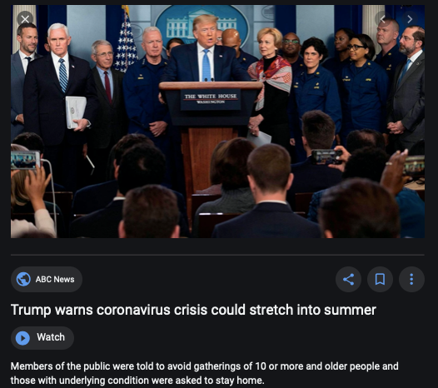
Coronavirus!

Slide 23
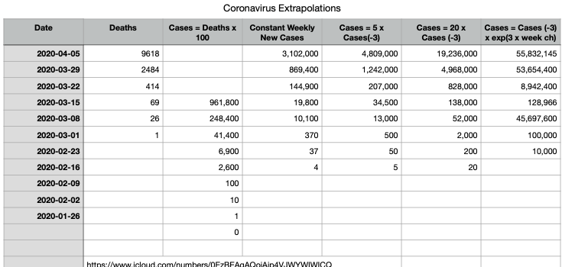
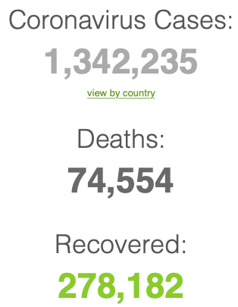
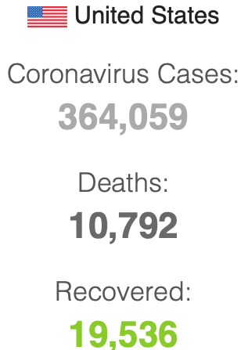

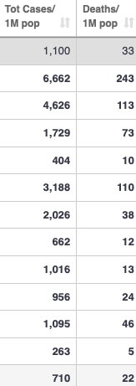
Coronavirus
Where we think we are, as of Mo Apr 6:
We really do not know
No random samples…
Best thing I have read comes from Jim Stock <https://drive.google.com/file/d/12MV466ZZy5xHir4xdPhoTrL1oO8CbZU-/view>:
The basic SIR epidemiological model of contagion
The effect of social distancing and business shutdowns on epidemic dynamics enters the model through a single parameter: the case transmission rate β
Re-express the model in terms of β and the asymptomatic (or not very symptomatic) hence non-tested rate—the fraction of the infected who are not tested
The COVID-19 non-testing rate is unidentified in our model
Estimates in the epidemiological literature range from 0.18 to 0.86.
The asymptomatic rate could be estimated accurately and quickly by testing a random sample
The optimal policy response and its economic consequences hinge critically on the asymptomatic rate

Slide 24
Where we think we are, as of Mo Apr 6:
We really do not know
No random samples…
Best thing I have read comes from Jim Stock <https://drive.google.com/file/d/12MV466ZZy5xHir4xdPhoTrL1oO8CbZU-/view>:
The basic SIR epidemiological model of contagion
The effect of social distancing and business shutdowns on epidemic dynamics enters the model through a single parameter: the case transmission rate β
Re-express the model in terms of β and the asymptomatic (or not very symptomatic) hence non-tested rate—the fraction of the infected who are not tested
The COVID-19 non-testing rate is unidentified in our model
Estimates in the epidemiological literature range from 0.18 to 0.86.
The asymptomatic rate could be estimated accurately and quickly by testing a random sample
The optimal policy response and its economic consequences hinge critically on the asymptomatic rate

Slide 28

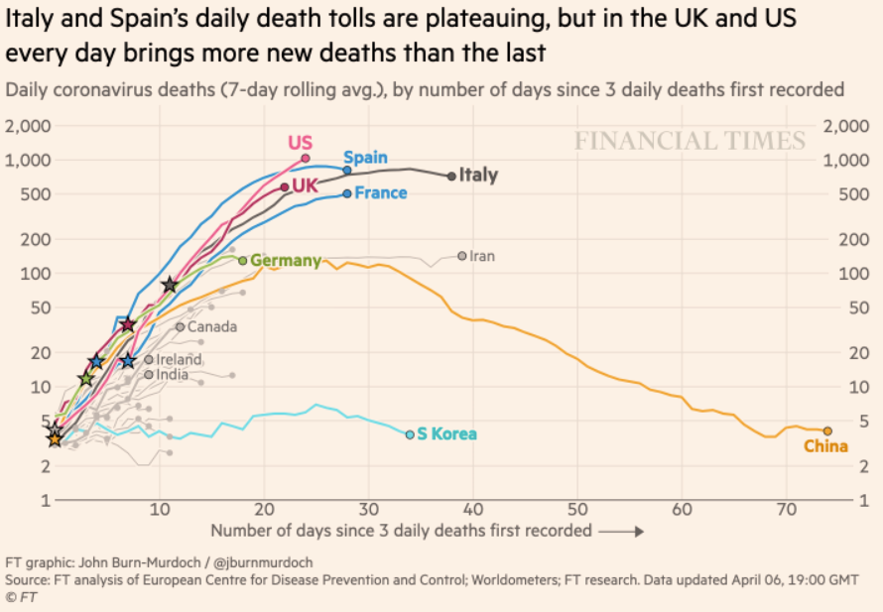
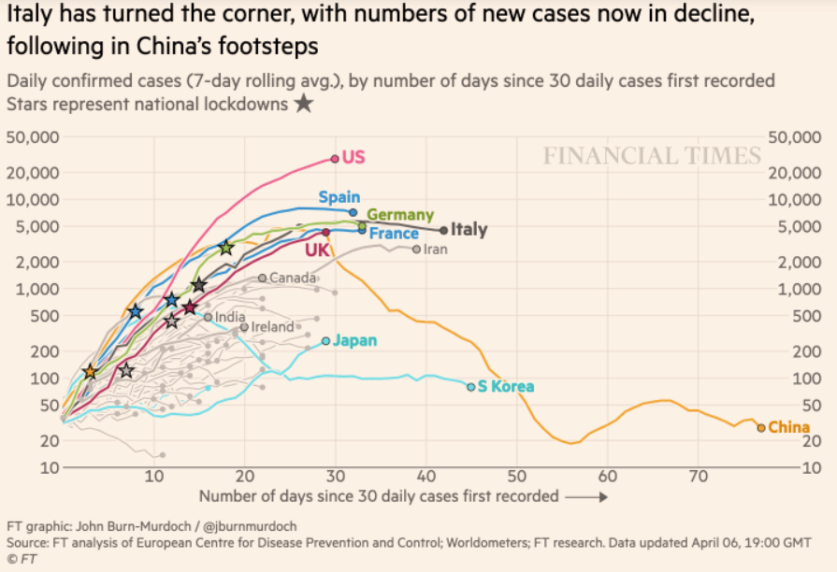
Financial Times Graphs Blown Up…

Slide 32

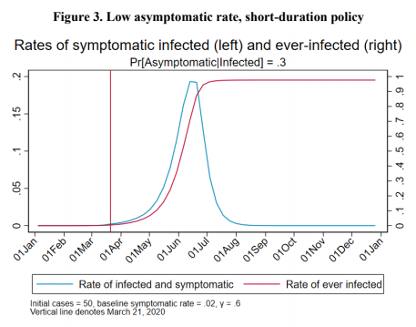

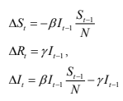
James Stock (2020)
Standard SIR model:<https://drive.google.com/file/d/12MV466ZZy5xHir4xdPhoTrL1oO8CbZU-/view>:
Susceptible, Infected, Recovered (& immune), transmission rate β, recovery rate γ, reproduction number R0, asymptomatic hence non-tested rate π0
Calibration: half-life of infection one week: γ = 0.5, s0 = 0.02, 50 cases on Jan 24
For March 21, 2020, the positive test rate in the United States is approximately 10%…
<https://drive.google.com/file/d/12MV466ZZy5xHir4xdPhoTrL1oO8CbZU-/view>

Slide 37
Bringing the Economy Back Up from Anæsthesia
Major issues:
Certificates of immunity:
Which requires test, test, test:
And not just disease virus tests
Presence-of-antibodies tests
How quickly can we match the immune with public-contact jobs?
What jobs can be done with minimal infection risk?
What minimal-infection substitutes can we find for previous jobs?
How quickly can restrictions be relaxed without the virus coming roaring back?
How do we avoid having the market give a “shutdown” signal to enterprises we in fact want restarted?
Which is pretty much all of them
How much of the potential caseload do we want to push out beyond the vaccine-arrival date?
ALL THESE QUESTIONS ARE ANSWERABLE IF WE LEARN THE ASYMPTOMATIC HENCE NON-TESTED RATE!!

Slide 38
Keeping the Economy from Crashing During the Lockdown
Nick Rowe: We have a 50% output cut in 100% of the sectors:
A temporary 100% output cut in 50% of the sectors (what the Coronavirus does) is very different from a 50% output cut in 100% of the sectors
Nick’s thought experiment:
In three months we are going to invent unobtanium:
Substantial intertemporal substitutibility
Plus lower cross-good contemporaneous substitutitbility
Hence high desired savings rate now
Flex-price market thus produces a nominal rate at the zero lower bound and a high inflation rate over the next three to six months
Plus liquidity-constrained workers in affected sectors see their demand go to zero immediately
Can we get there? Should we get there? What should we do instead?
We need a good RBC economist: are there any?…
<https://worthwhile.typepad.com/worthwhile_canadian_initi/2020/03/relative-supply-shocks-unobtainium-walras-law-and-the-coronavirus.html>

Slide 39
Keeping the Economy from Crashing During the Lockdown II
Nick Rowe <https://worthwhile.typepad.com/worthwhile_canadian_initi/2020/03/relative-supply-shocks-unobtainium-walras-law-and-the-coronavirus.html>:
Plus: to extend the thought experiment:
We just lost the ability to make “unobtainium”
So we should be substituting leisure for work, and moving workers into relatively unproductive labor, making the commodities we can still produce right now
How should relative prices move as a result? How should we make them move?
Plus: distributional issues
Plus: bankruptcy and credit chain issues

Slide 40

MOAR Coronavirus!
Death for Geezers!
Mortality for the Youngs very low…
It’s the flu for them—for you…
And an extra doubling—or is it 5%?—mortality for the asthmatic
And an extra doubling—or is it 5%?—mortality for the overweight

Slide 41
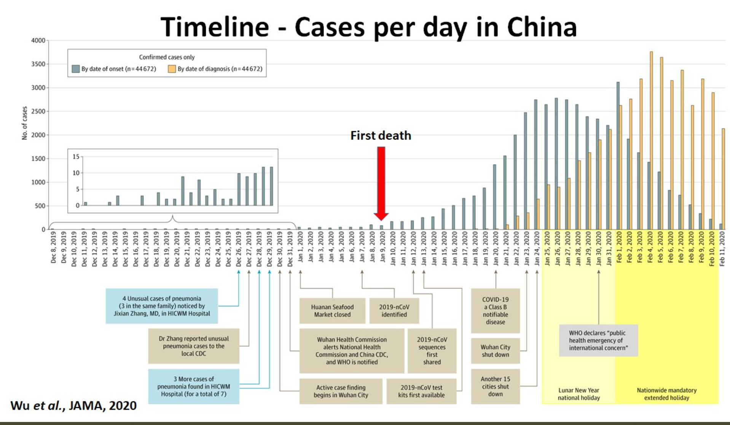
What We Think Happened in Wuhan
China beat it quickly & relatively easily!
We think
Shut down Wuhan when 200 cases per day
That seems to have been a good decision

Slide 42

The Goal
When Is It Appropriate to Move on This?
Immediate social distancing…
Self-isolate if you have a cough and a fever…
Hope that warmer temperatures will do to this what they did to SARS…
Otherwise, when do you want to start spreading out transmission. It seems that early is as good as later, so do it early…
I have no good intuition on why you want to move early
Plus your moving early will be wasted if you get reinfected
Plus the sparks you throw off making others’ lives more difficult

Slide 43
References
Financial Times (2020): Coronavirus Tracked: The Latest Figures as the Pandemic Spreads <https://www.ft.com/coronavirus-latest>
Nick Rowe (2020): Relative Supply Shocks, Unobtainium, Walras' Law, and the Coronavirus <https://worthwhile.typepad.com/worthwhile_canadian_initi/2020/03/relative-supply-shocks-unobtainium-walras-law-and-the-coronavirus.html>
Jim Stock (2020): Coronavirus Data Gaps and the Policy Response <https://drive.google.com/file/d/12MV466ZZy5xHir4xdPhoTrL1oO8CbZU-/view>

Slide 44
MOAR Coronavirus!
What I am watching:
Max Roser & Hannah Ritchie: Coronavirus Disease (COVID-19) <https://ourworldindata.org/coronavirus>…
Worldometer: Coronavirus Update (Live) <https://www.worldometers.info/coronavirus/>: ‘125,599 Cases and 4,605 Deaths from COVID-19 Virus Outbreak…
FT Coronavirus Tracker <https://www.ft.com/content/a26fbf7e-48f8-11ea-aeb3-955839e06441>
Josh Marshall’s COVID Twitter List <https://twitter.com/i/lists/1233998285779632128>
NEJM Group: Updates on the Covid-19 Pandemic <http://m.n.nejm.org/nl/jsp/m.jsp?c=%40kxNtXckRDOq8oG0jJvAXsIzN4mPECIPhltxoTSdTU9k%3D&cid=DM89089_NEJM_COVID-19_Newsletter&bid=173498255>: 'From the New England Journal of Medicine, NEJM Journal Watch, NEJM Catalyst, and other trusted sources...

Slide 45
Catch Our Breath…
Ask a couple of questions?
Make a couple of comments?
Any more readings to recommend?
<https://www.icloud.com/keynote/0YKEi7HeOrVGvKYtt9FEqH7nA>

Slide 46
Coronavirus! (March 16)
With 31 deaths in the U.S. as of March 11, a 1% death rate, and up to 4 weeks between infection and death, that means that as of Feb 12 there were 3100 coronavirus cases in the United States.
With 87 deaths in the U.S. as of Mar 16, a 1% death rate, and up to 4 weeks between infection and death, that means that as of Feb 17 there were 8700 coronavirus cases in the United States
If it is doubling every seven days, then now about 150,000 people have and in the next week about 150,000 more people in the U.S. will catch coronavirus—which means 1/2200, currently 3500 of the 7.6 million inhabitants of San Francisco Bay. Touch a hard surface that any of those 3500 has touched in the last 48 hours, and the virus has a chance to jump to you…
These numbers could be five times too big. These numbers are probably not five times too small unless the thing is a lot less deadly, and there are a lot of asymptomatic cases…
What is wrong with this analysis?

Slide 47

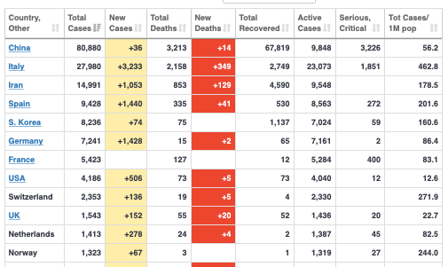
MOAR Coronavirus!
As of March 21: Things are not moving in the right direction:
What is the R0?
How can the R0 be changed?
How will the R0 change?
What is the asymptote share of the population?
What is the mortality rate?

Slide 48

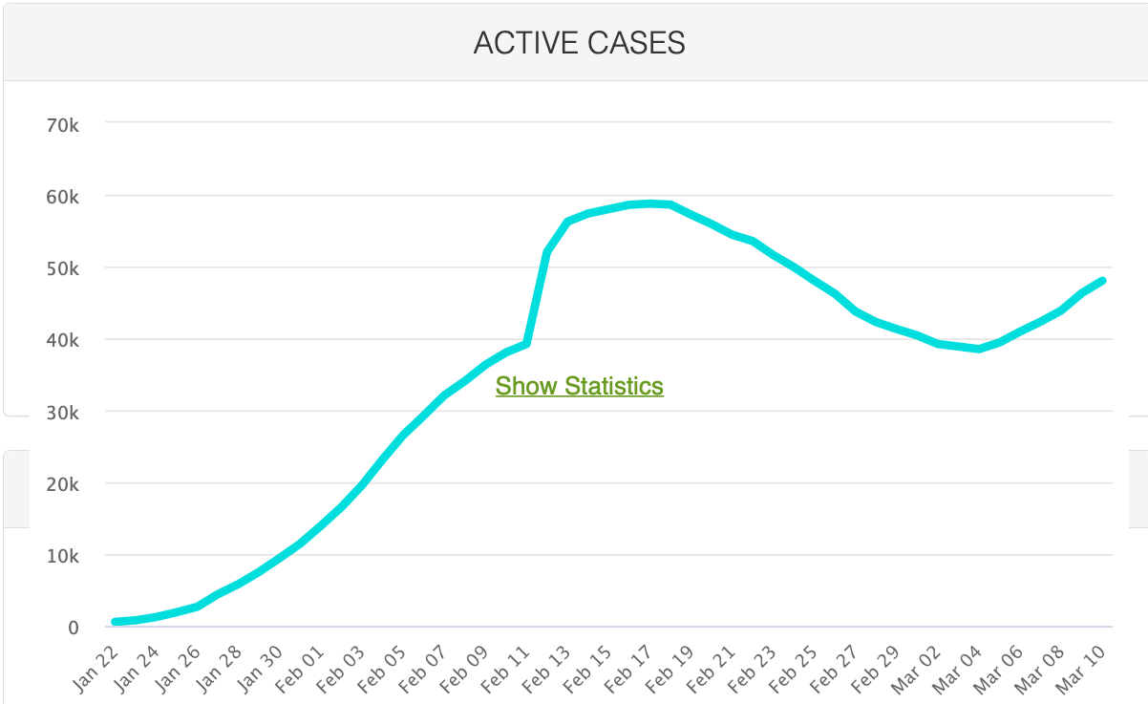
MOAR Coronavirus!
As of March 10: Things are not moving in the right direction:
What is the R0?
How can the R0 be changed?
How will the R0 change?
What is the asymptote share of the population?
What is the mortality rate?

Slide 49
Notes

Slide 50
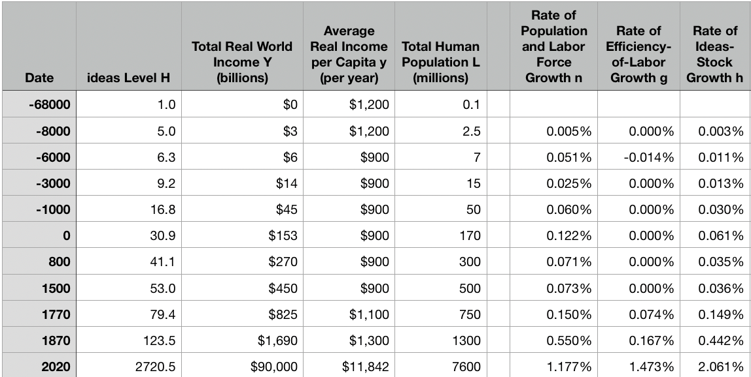
Reviews
Post-1870 is the miracle:

Slide 51
Review: The Broad Sweep
Post-1870 is the miracle:

Slide 52
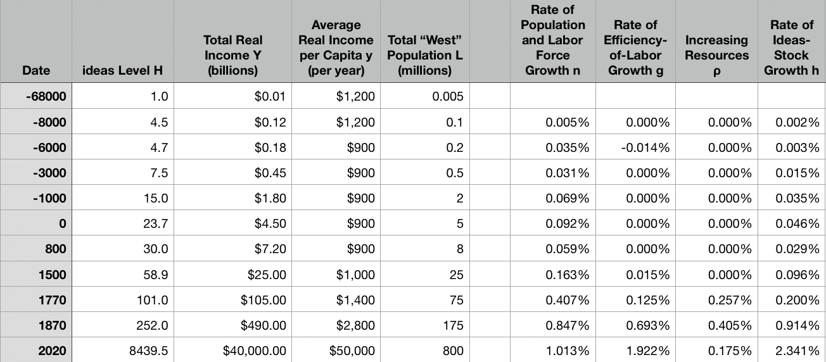
“The West”
800, 1500, 1770, or 1870?:

Slide 53
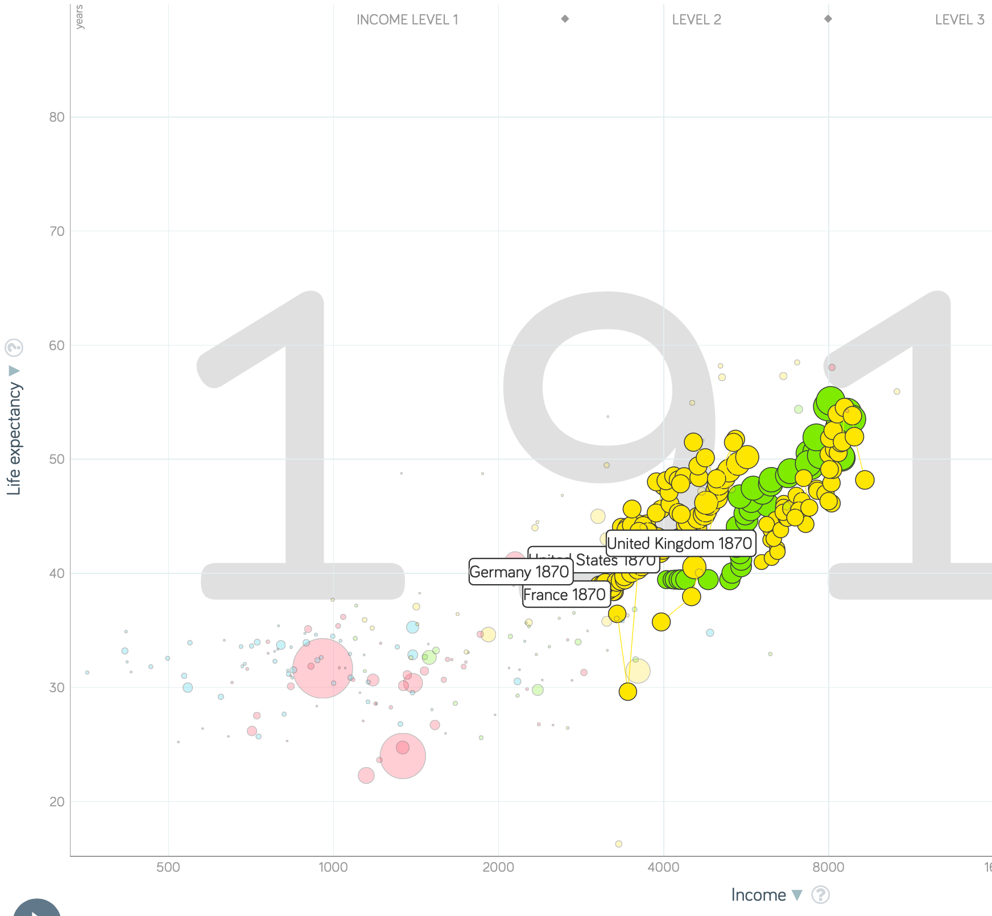
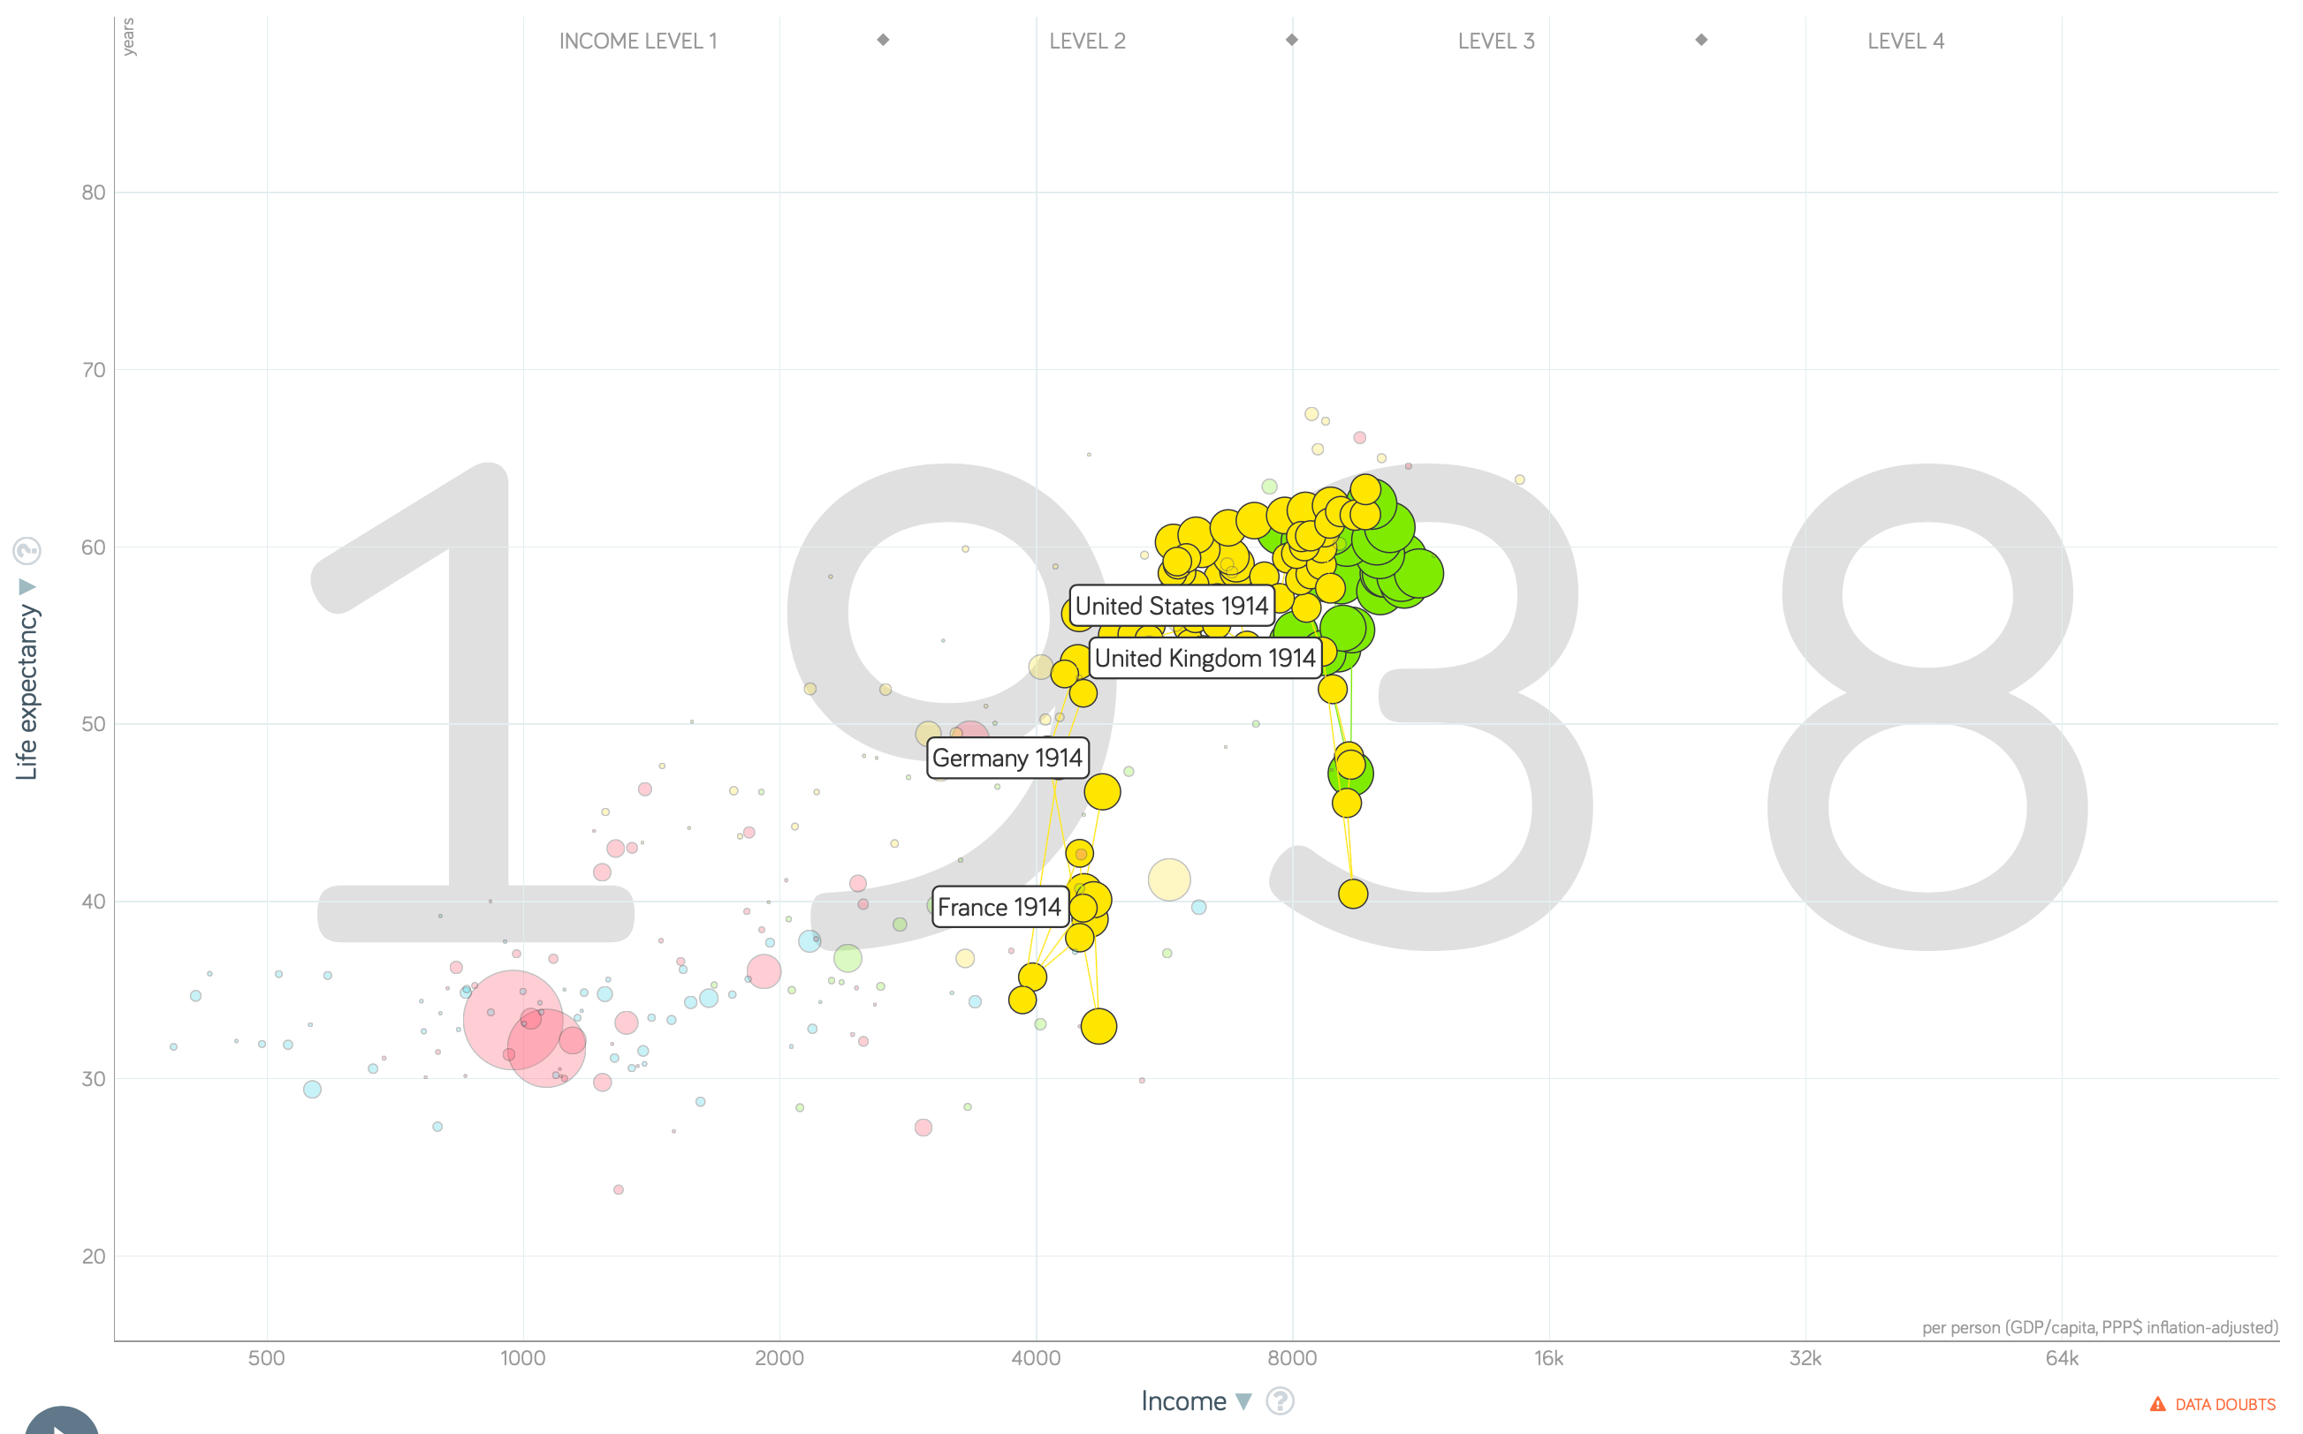
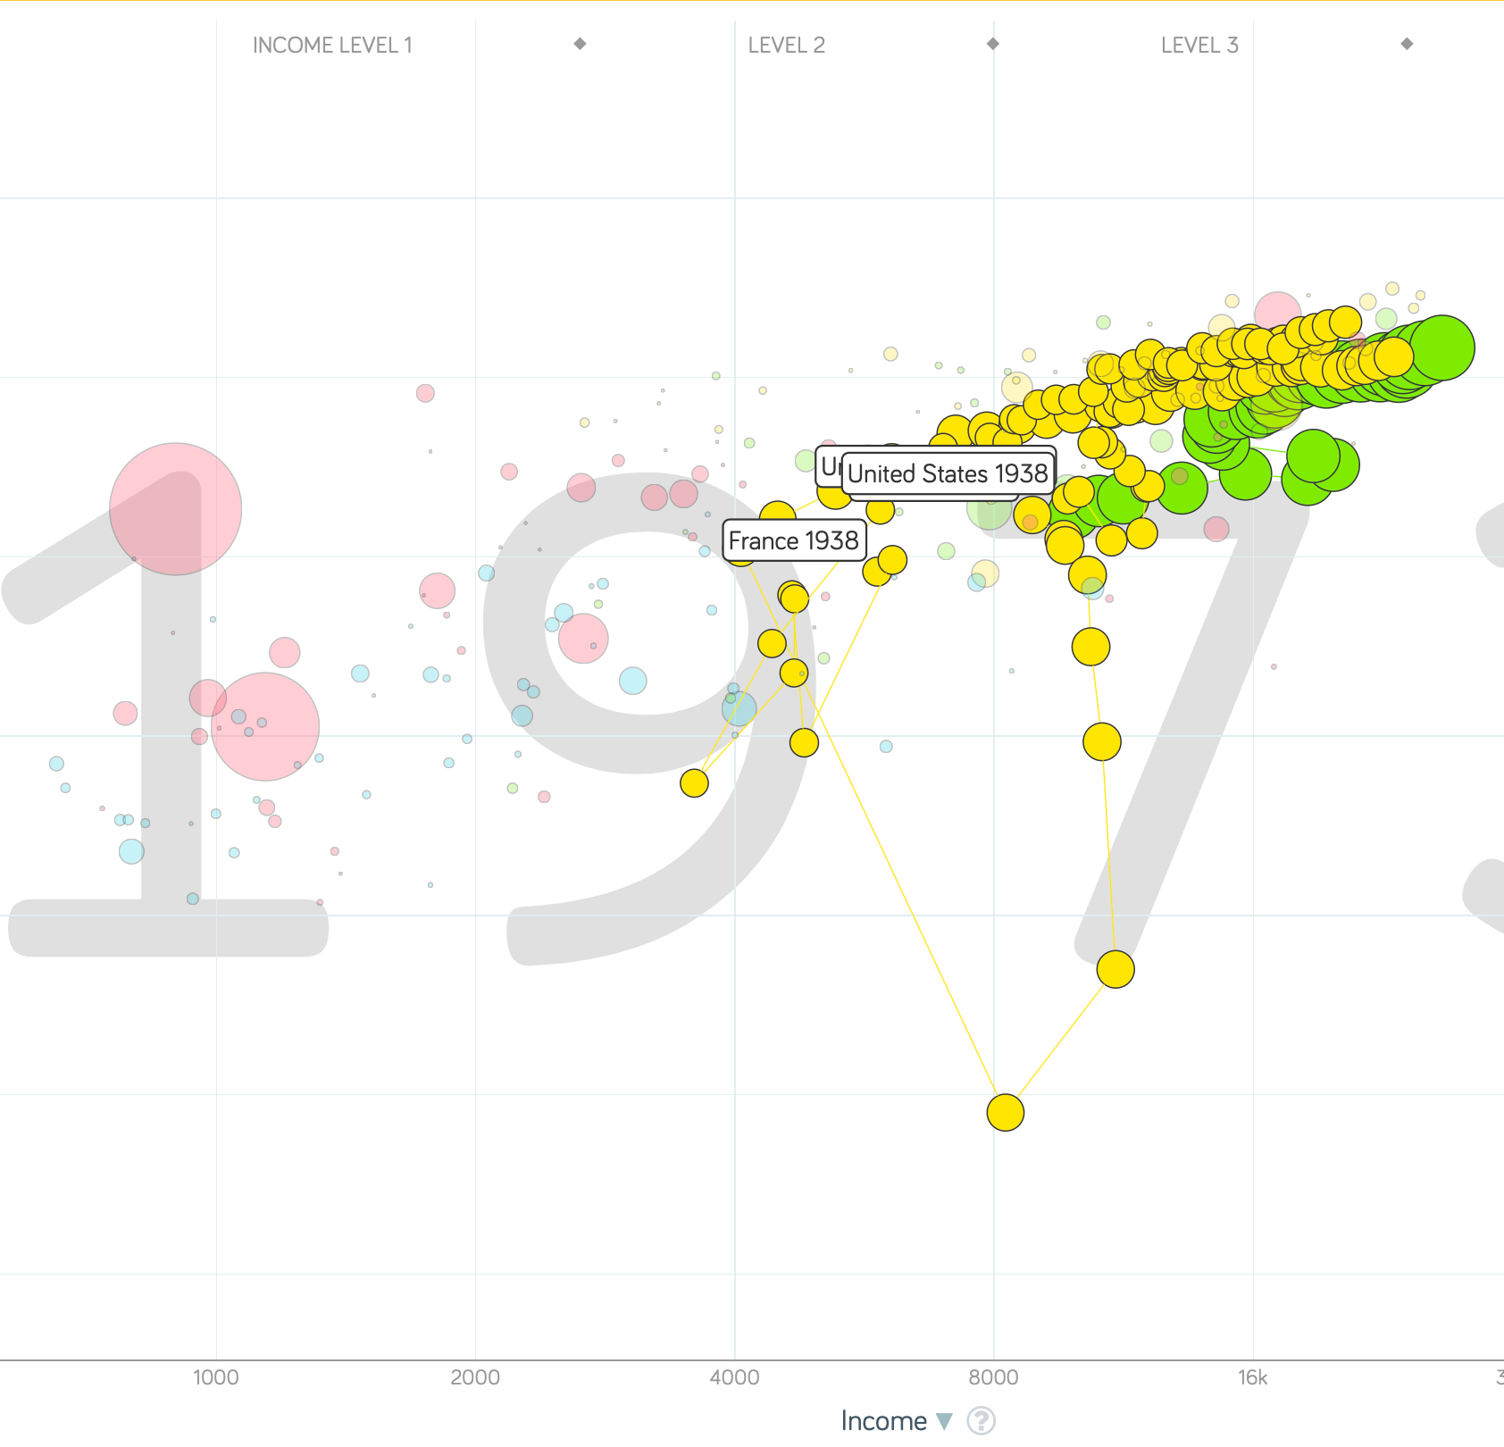
“The West”
1914-1938, 1870-1913, & 1938-1973
Rate of growth in the North Atlantic industrial core halves comparing 1870-1913 to 1914-1938; then triples afterwards over 1938-1973
Slows again after 1973

Slide 54
To Your iClickers
What was the growth rate of ideas in the industrial core of the world economy over 1870-2020?
About 2.3%/year
About 0.9%/year
About 0.23%/year
About 4%/year
None of the above

Slide 55
To Your iClickers
What was the growth rate of ideas in the industrial core of the world economy over 1770-1870?
About 2.3%/year
About 0.9%/year
About 0.23%/year
About 4%/year
None of the above

Slide 56
Review: The Belle Époque Broken
John Maynard Keynes:
“Very few of us realise[d] with conviction the intensely unusual, unstable, complicated, unreliable, temporary nature of the economic organisation by which Western Europe has lived for the last half century. We assume some of the most peculiar and temporary of our late advantages as natural, permanent, and to be depended on, and we lay our plans accordingly.
“On this sandy and false foundation we scheme for social improvement and dress our political platforms, pursue our animosities and particular ambitions, and feel ourselves with enough margin in hand to foster, not assuage, civil conflict in the European family....
“France, Germany, Italy, Austria, and Holland, Russia and Roumania and Poland, throb together, and their structure and civilisation are essentially one. They flourished together, they have rocked together in a war which we, in spite of our enormous contributions and sacrifices (like though in a less degree than America), economically stood outside, and they may fall together…”

Slide 57
Aristocracy & Social Democracy
The aristocrats had rolled the dice:
Europe in 1914 was a Europe of national populations, of industrialists and socialists, of factory workers and technicians…
Europe’s governments in 1914—especially the defense and foreign affairs ministries—had been populated by aristocrats, ex-aristocrats, and would-be aristocrats.
Landed, aristocratic, military elites had control of many of the levers of propaganda and power…
Aristocrats had had help. Industrialists and entrepreneurs were eager to provide their political support in return for economic benefits, as in the 1879 German “marriage of iron and rye”: the imposition of tariffs on imports of British steel (to protect the positions of German manufacturers) and on imports of American grain (to protect the positions of German landlords)…
On the eve of World War I, these landed military service aristocrats, ex-aristocrats, and would-be aristocrats increasingly found themselves members of a social caste that had no societal function…
But power—in the form of office and of vast (if declining relative) wealth—and propaganda—in the form of pageantry and the press—were reinforced by ideologies: Social darwinism…
The aristocrats rolled the dice—and lost…
Social democrats picked up the chips:
Expanded suffrage…
Proportional representation…
“Lands fit for heroes…”
How to provide for the benefits politicians promised?

Slide 58
Reparations, Taxes, and Inflation
Reparations
A peace “without annexations and indemnities”…
But not without reparations…
Two years’ of Germany’s national income demanded:
Much of it “boob bait for the bubbas…” on the part of Allied politicians…
But a powerful shaper of post-WWI Germany
Taxes
High and progressive tax rates…
A powerful impact on inequality…
Class war…
Inflation
U.S.: price level x1.5
Britain: price level x2.0
France: price level x7.0
French government had encouraged investment in Russian bonds…
German: price level x1,000,000,000,000
Austria, Hungary, Czechoslovakia the same…

Slide 59
Keynes’s Protest
Jan Christian Smuts:
“Poor Keynes often sits with me at night after a good dinner and we rail against the world and the coming flood. And I tell him that this is the time for Grigua’s prayer (the Lord to come himself and not to send his Son, as this is not a time for children). And then we laugh, and behind the laughter is [Herbert] Hoover’s horrible picture of thirty million people who must die unless there is some great intervention. But then again we think that things are never really as bad as that; and something will turn up, and the worst will never be. And somehow all these phases of feeling are true and right in some sense…”

Slide 60
Keynes’s Protest II
John Maynard Keynes:
“If we aim deliberately at the impoverishment of Central Europe, vengeance, I dare predict, will not limp. Nothing can then delay for long that final civil war between the forces of reaction and the despairing convulsions of revolution, before which the horrors of the late German war will fade into nothing, and which will destroy... the civilization and progress of our generation…”

Slide 61
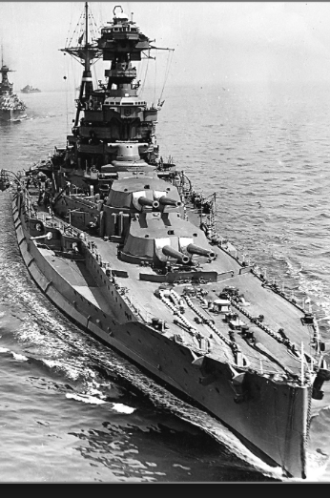
Review: World War I
Nationalism
Max Weber: “The vulgar conception of political economy is that it consists in working out recipes for making the world happy.… However… elbow-room… can [only] be won… through the hard struggle.... That standard of value adopted by a German economic theorist, can… be nothing other than a German policy and a German standard.... Our successors will... hold us responsible... for the amount of elbow-room we conquer.... The science of political economy is... a servant of... the lasting political-power interests of... our nation's power, and the vehicle of that power, the German national state…”
Erich von Manstein: von Manstein, von Lewinsky, Lewinski, Levi…
“We offered 4 battleships a year, the navy demanded 6, and we compromised at 8”

Slide 62
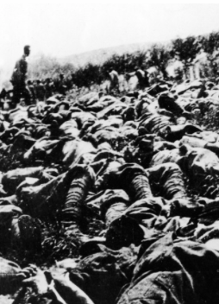
The Catastrophe of World War I: Origins
In the summer of 1914 the empires of Russia and Austria-Hungary are skirmishing diplomatically and threatening each other militarily about the latest Balkan crisis
Began when in the summer of 1914 the Archduke Franz Ferdinand and his wife Sophie were assassinated in Sarajevo
By terrorists with very close links to the intelligence service of the Kingdom of Serbia
What would Austria’s response be?
And then Germany attacks Belgium
And then Australia attacks Turkey

Slide 63
The Catastrophe of World War I: Causes
Why?: “If there is a war, let it come now…”
Russia thought it would have to fight Germany someday, and might as well while France was interested…
Austria, France, Britain (as a result of the German battle fleet) the same
“Busy giddy minds with foreign quarrels…”
A wiser man: Otto von Bismarck:
“There is nothing in the Balkans worth the bones of a single Pomeranian grenadier…”

Slide 64
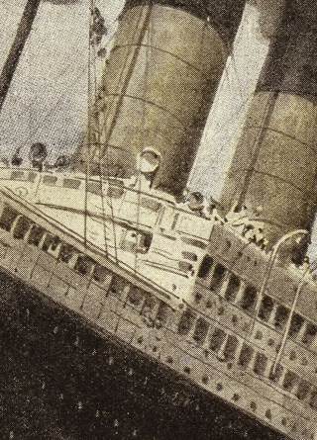
How Does the U.S. Get Involved?
British policy: binding the U.S. upper class to Britain since the 1840s
The Law of the Sea
Neutrals
Blockade
The submarine
Unrestricted submarine warfare
Zimmerman Telegram
Woodrow Wilson
“Teach the Mexicans to elect good men…”
“The war to end war…”

Slide 65
The Catastrophe of World War I: Outcome—Human
Combatants had mobilized 65M out of 100M men of military age
10M killed
10M maimed
Civilian casualties less than 10% of military
Costs of 1.5x a year’s GDP
Plus a 15M global flu epidemic
Russian, Austro-Hungarian, German, Ottoman Turkish Empires all gone…
Representative governments destabilized—or weak…
The Russian Revolution…
Hungarian, Bavarian socialist republics (short-lived)
Spartakist…
Allies demand 2 years of German GDP as “reparations”…

Slide 66
Catch Our Breath…
Comments?
Questions?

Slide 67

Review: Edward Bellamy: Looking Backward
Edward Bellamy: Looking Backward <https://delong.typepad.com/files/bellamy-backward.pdf>: Perhaps the third best-selling novel of the 19th century in the United States
2000 is a utopia…
The narrator is carried forward in time from 1887-2000 by an implausible plot device:
‘“This is the tenth day of September in the year 2000, and you have slept exactly one hundred and thirteen years, three months, and eleven days…”’
He then wanders around, looking at the utopia of 2000…
The opening:
‘“How could I live without service to the world?” you ask…. The answer is that my great-grandfather had accumulated a sum of money on which his descendants had ever since…. The sum had been originally by no means large. It was, in fact, much larger now that three generations had been supported upon it in idleness, than it was at first…’

Slide 68
The Stagecoach of Society
Those who ride and this who pull:
‘Commiseration was frequently expressed by those who rode for those who had to pull the coach, especially when the vehicle came to a bad place in the road, as it was constantly doing, or to a particularly steep hill. At such times, the desperate straining of the team, their agonized leaping and plunging under the pitiless lashing of hunger, the many who fainted at the rope and were trampled in the mire, made a very distressing spectacle, which often called forth highly creditable displays of feeling on the top of the coach.
‘At such times the passengers would call down encouragingly to the toilers of the rope, exhorting them to patience, and holding out hopes of possible compensation in another world for the hardness of their lot, while others contributed to buy salves and liniments for the crippled and injured. It was agreed that it was a great pity that the coach should be so hard to pull, and there was a sense of general relief when the specially bad piece of road was gotten over. This relief was not, indeed, wholly on account of the team, for there was always some danger at these bad places of a general overturn in which all would lose their seats.
‘It must in truth be admitted that the main effect of the spectacle of the misery of the toilers at the rope was to enhance the passengers’ sense of the value of their seats upon the coach, and to cause them to hold on to them more desperately than before…

Slide 69
The Stagecoach of Society II
“Finer clay”:
‘The other fact is yet more curious, consisting in a singular hallucination which those on the top of the coach generally shared, that they were not exactly like their brothers and sisters who pulled at the rope, but of finer clay, in some way belonging to a higher order of beings who might justly expect to be drawn. This seems unaccountable, but, as I once rode on this very coach and shared that very hallucination, I ought to be believed.
‘The strangest thing about the hallucination was that those who had but just climbed up from the ground, before they had outgrown the marks of the rope upon their hands, began to fall under its influence. As for those whose parents and grand-parents before them had been so fortunate as to keep their seats on the top, the conviction they cherished of the essential difference between their sort of humanity and the common article was absolute. The effect of such a delusion in moderating fellow feeling for the sufferings of the mass of men into a distant and philosophical compassion is obvious.
‘To it I refer as the only extenuation I can offer for the indifference which, at the period I write of, marked my own attitude toward the misery of my brothers…

Slide 70
The Stagecoach of Society III
Class war:
‘The sanguine argued very forcibly that it was in the very nature of things impossible that the new hopes of the workingmen could be satisfied, simply because the world had not the wherewithal to satisfy them. It was only because the masses worked very hard and lived on short commons that the race did not starve outright, and no considerable improvement in their condition was possible while the world, as a whole, remained so poor.
‘It was not the capitalists whom the laboring men were contending with, these maintained, but the iron-bound environment of humanity, and it was merely a question of the thickness of their skulls when they would discover the fact and make up their minds to endure what they could not cure.
The less sanguine admitted all this. Of course the workingmen’s aspirations were impossible of fulfillment for natural reasons, but there were grounds to fear that they would not discover this fact until they had made a sad mess of society. They had the votes and the power to do so if they pleased, and their leaders meant they should. Some of these desponding observers went so far as to predict an impending social cataclysm. Humanity, they argued, having climbed to the top round of the ladder of civilization, was about to take a header into chaos…’

Slide 71
The Limit of Human Felicity I
In the music room:
‘She made me sit down comfortably, and, crossing the room, so far as I could see, merely touched one or two screws, and at once the room was filled with the music of a grand organ anthem; filled, not flooded, for, by some means, the volume of melody had been per- fectly graduated to the size of the apartment. I listened, scarcely breathing, to the close. Such music, so perfectly rendered, I had never expected to hear.
‘“Grand!” I cried, as the last great wave of sound broke and ebbed away into silence. “Bach must be at the keys of that organ; but where is the organ?”…
‘“There are a number of music rooms in the city, perfectly adapted acoustically to the different sorts of music. These halls are connected by telephone with all the houses of the city…. Any one of the four pieces now going on that you prefer, you can hear by merely pressing the button which will connect your house-wire with the hall where it is being rendered…”’

Slide 72
The Limit of Human Felicity III
Four live orchestras you can listen to on the speakerphone!
‘“It appears to me, Miss Leete,” I said, “that if we could have devised an arrangement for providing everybody with music in their homes, perfect in quality, unlimited in quantity, suited to every mood, and beginning and ceasing at will, we should have considered the limit of human felicity already attained, and ceased to strive for further improvements…”’

Slide 73
Review: The View from 3000: Themes & Big Ideas
Science reaches critical mass and from it springs engineering—all of the engineering subdisciplines, including the management of human resources and of organizations. From a liberal political order spring national and then the global market economy. And from engineering and the market, and the large bureaucratic corporation then, over the course of 1870-2016, spring…
History was economic…
Explosion of wealth…
Cornucopia of technology…
Demographic transition…
Feminist revolution…
Inclusion and hierarchy attenuation…
Empowered tyrannies…
Wealth gulfs…
Mismanagement and insecurity…

Slide 74
Measuring Growth
What are my estimates of the rate of growth of economically-useful human knowledge over 1-1500, 1500-1800, 1800-1870, and 1870-2000?
0.02%/year, 0.2%/year, 0.5%/year, and 0.8%/year
0.000%/year, 0.02%/year, 0.2%/year, and 0.8%/year
0.02%/year, 0.2%/year, 0.8%/year, and 2.3%/year
0.2%/year, 0.8%/year, 2.3%/year, and 4.7%/year
None of the above.

Slide 75
What Is the Key Factor in the Explosion of Wealth in the 20th Century?
Yes, many things contributed. But suppose you have to pick just one

Slide 76
What Are the Four Factors That I See as Making for the Explosion of Wealth in the 20th Century?
Yes, there are many, many more things that contributed. But suppose you have to pick just four:

Slide 77
Demography II
What is the principal cause of the demographic transition?
Female wealth and control of property.
Female literacy.
Falling infant and child mortality.
Land shortages and high unemployment.
Something else.

Slide 78
Feminism
How many pregnancies do we think Abigail Smith Adams had between when she was 20 and 34?
2.
4.
6.
8.
18.

Slide 79
Empowered Tyrannies II
How many world leaders are members of the 10-million club?
2.
4.
6.
8.
18.

Slide 80
Inclusion and Hierarchy Attenuation
At the start of the 1970s, future President Ronald Reagan said that diplomats from Tanzania appeared uncomfortable:
resisting pressure to vote with the Soviet Union at the United Nations.
making small talk with New York socialites.
wearing shoes.
in formal tuxedos.
None of the above.

Slide 81
Economic Mismanagement and Insecurity II
According to Karl Polanyi, what rights does the market economy respect?
rights to land (a stable community).
rights to labor (a “just” income).
rights to finance (a stable economic place).
rights to property (the ability to keep what you manage to claim to earn).
None of the above.

Slide 82
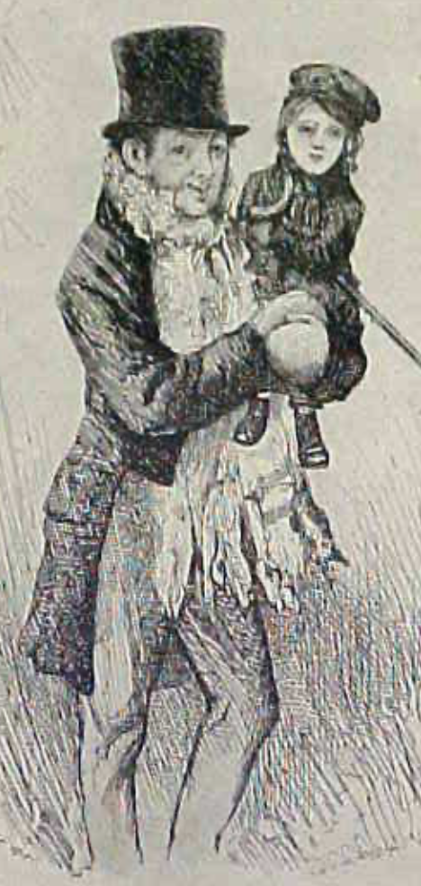
Review: The Watershed: 1870 as an Inflection Point
As of 1870, had the Industrial Revolution raised the standard of living or lightened the toil of the working class in England, the country at its center?
Yes
No
It’s not clear
Why? Malthusian forces—population explosion & thus smaller farm sizes. Growth, the growth had been slow 0.8%/year?

Slide 83
Globalization
Who called the era of globalization and growth from 1870 to 1914 an “economic El Dorado”?
Karl Marx
John Stuart Mill
Thomas Robert Malthus
John Maynard Keynes
None of the above
What would the others have said?

Slide 84
Migration
How many people of the roughly 1.5 billion then-population of the world left their continents of origin between 1870-1913?
10 million
50 million
100 million
200 million
400 million

Slide 85
Before 1870, Ideas Growth Not Fast Enough
And population growth accelerates as the world is not rich enough to undergo the demographic transition:
Value of useful and deployed ideas about technology and organization
-8000: 1
1: 3.5
1500: 4.75
1800: 9
1870: 16
2020: 421
Growth Rates:
-8000 to 1500: 0.02%/year
1500 to 1800: 0.2%/year
1800 to 1870: 0.8%/year
1870 to 2020: 2.3%/year
What caused these accelerations? What caused this last acceleration?

Slide 86
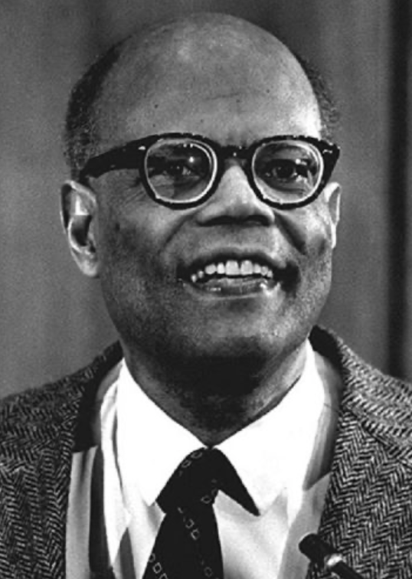
The Last Acceleration
The industrial research lab to routinize invention, and the modern corporation to routinize diffusion and deployment
Plus general purpose technologies—machine tools, non-human power sources
Arthur Lewis:
“New commodities: telephones, gramophones, typewriters, cameras, automobiles, and so on, a seemingly endless process whose latest twentieth-century additions include aeroplanes, radios, refrigerators, washing machines, television sets, and pleasure boats. Thus a rich man in 1870 did not possess anything that a rich man of 1770 had not possessed; he might have more or larger houses, more clothes, more pictures, more horses and carriages, or more furniture than say a school teacher possessed, but as likely as not his riches were displayed in the number of servants whom he employed rather than in his personal use of commodities…”
Not so much the particular technologies, as the grasping of the fact that there was a broad and deep range of new technologies to be discovered.
As much as it was new technologies, it was large-scale corporate organizations that could and did plan the division of labor to make use of and then market technologies.
And as much, it was that the global market meant that there was now a great deal of money to be made from the routinization of the exploration, development, and deployment of technological possibilities

Slide 87
Worldwide: The Broad Sweep
Post-1870 is the miracle:

Slide 88
“The West”
800, 1500, 1770, or 1870?:

Slide 89
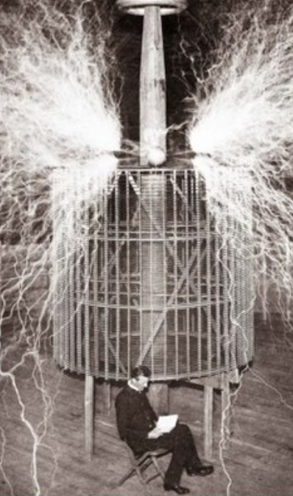
Who Is This Man?
And is he in any real danger?
Thomas Edison, and no
Andrew Carnegie, and no
Nicola Tesla, and no
Thomas Edison, and yes
Herbert Hoover, and yes

Slide 90
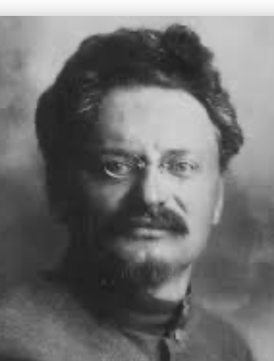
Lev Bronstein
Why did he say this?
“I had had no time to more than catch the general life-rhythm of the monster known as New York…”
“I left for Europe with the feeling of a man who has had only a peek into the furnace where the future is being forged…"

Slide 91

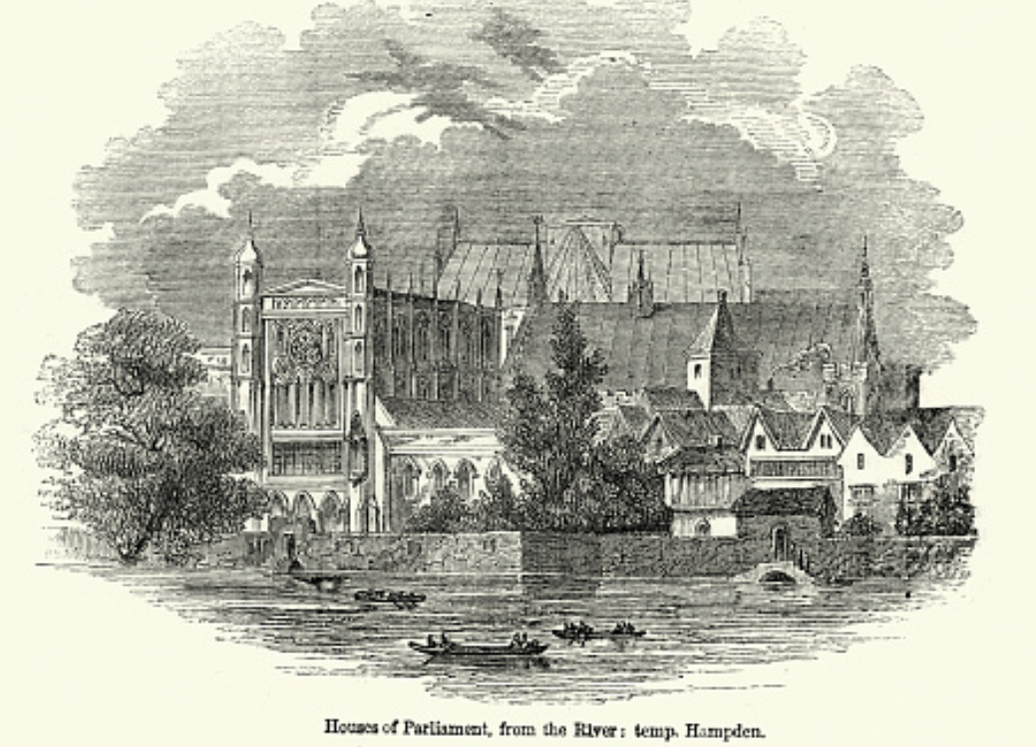
Review: Political Economy
From “Divine Right” and “Natural Order” to Enlightenment values…
Who was the first person to draft these words:?
“We hold these truths to be sacred & undeniable:
that all men are created equal & independant,
that from that equal creation they derive rights inherent & inalienable,
among which are the preservation of life, & liberty, & the pursuit of happiness;
that to secure these ends, governments are instituted among men, deriving their just powers from the consent of the governed…”
John Locke
Niccolo Machiavelli
Thomas Hobbes
Thomas Jefferson
George Washington
Why did he write them?

Slide 92
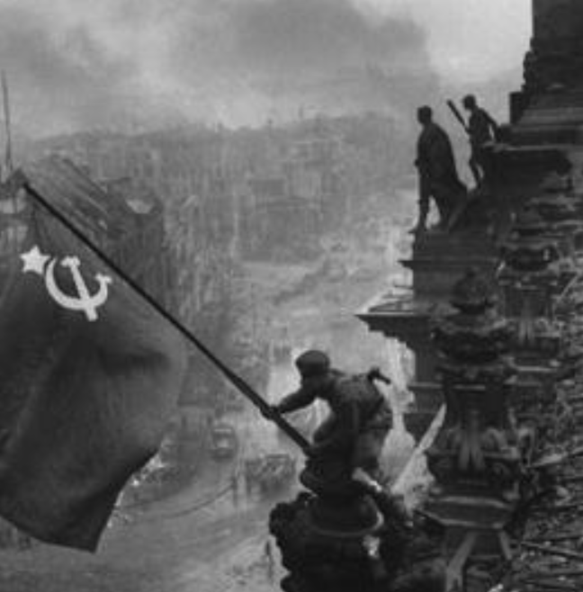
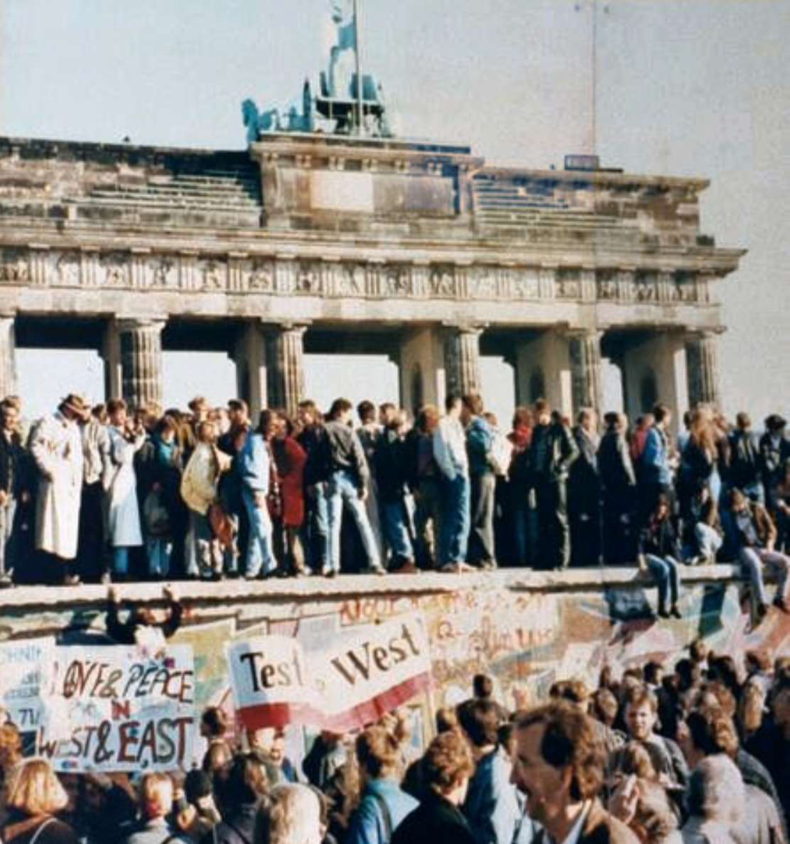
What Was the Proper Political Order?
Fears of “democracy” among American founders:
Madison: “Democracies have ever been spectacles of turbulence and contention... incompatible with personal security or the rights of property... as short in their lives as... violent in their deaths…”
Jefferson: “Gen’l Washington had not a firm confidence in the durability of our government… [& this] had some weight in his adoption of… ceremonies… calculated to prepare us gradually for a change which he believed possible…”
Hamilton: “the British government… best” as the only one “unit[ing] public strength with individual security…”
Adams: The American president should be announced as: “His Highness, the President of the United States, and Protector of the Rights of the Same…”
Question of political order thought settled: first in the rubble of Berlin in 1945, and then in the streets of East Germany in 1991:
Settled in favor of representative democracy, private property, & social insurance—late-1900s liberal democracy
But now reopened? Min Zhu (朱民) to me in 2015: “What are you Americans going to do to fix your broken political system?”

Slide 93
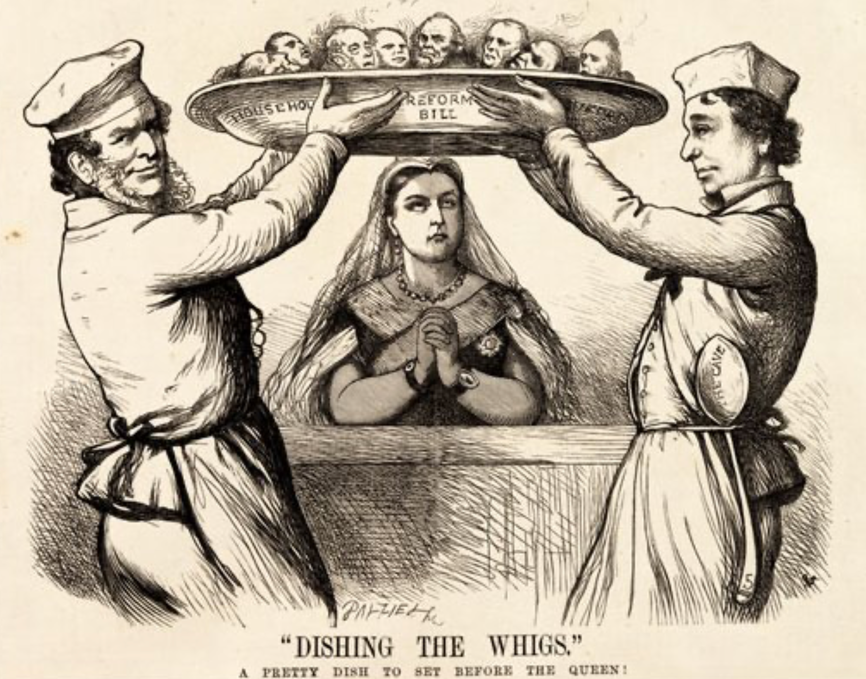
Franchise Restricted to the Rich Could Not Maintain Itself
The dynamic of franchise extension
Liberals in power would try extend on the principle that the new, poorer voters would be less conservative and would support them.
Threatening revolution would lead even conservatives to seek to extend the franchise in order to peel off of the revolutionary coalition those of the disenfranchised who had the most social power:
Earl Grey (yes, the tea): “The Principal… is to prevent… revolution…. I am reforming to preserve, not to overthrow…”
Charismatic leaders with popular followings would seek to give them votes, and then rule via plebiscites—going around the traditional elites
(Peculiar thing about Trump-Johnson: minority, and core is a minority of a minority…)
Conservatives: “dish the Whigs”—opportunities to form winning coalitions by appealing to those who were no profiting from the market economy, or felt that they were losing relative status in some ways…

Slide 94
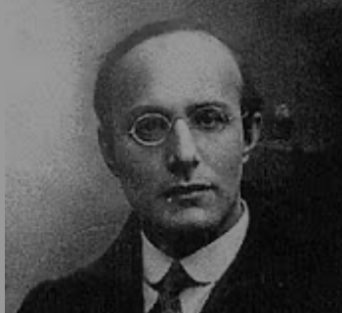
Popular Government and the Market Economy: Society’s Revenge
Karl Polanyi
People believe they have rights—to stable, supportive, nurturing communities; to incomes commensurate with their skills and status; and to money flows that will provide economic stability…
But a market society turns these things—land, labor, and finance—into commodities…
But they are not real commodities, they are fictitious commodities
And so you get your rights only if they satisfy a market profitability test
The only rights a market society respects are property rights:
& the only property rights that are worth anything are those that help you produce things for which rich people have a serious jones
Society will have its revenge: it will protect itself against the market logic, somehow, some way…

Slide 95
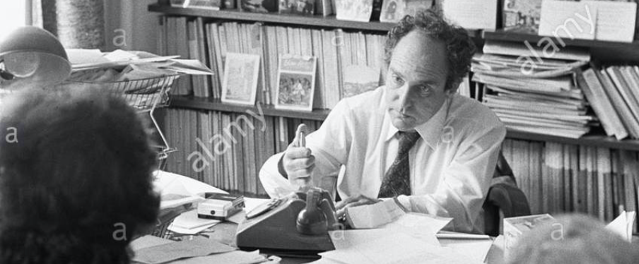


Digression: 5 Thinkers
Who shape my thought about the long 20th century—and how should, I think, shape yours
Beware! They are all deeply flawed…
But they are also geniuses, each in his way…
Beware of their followers! An iron law of ideology: a thinker’s most extravagant and aggressive followers will latch onto the stupidest and most shortsighted and wrong of their doctrines…
In historical order: Marx, Keynes, Hayek, Polanyi, Gellner
The other three thinkers:
Keynes: All that we need to produce general prosperity is technical adjustments to our system. Then the kingdom of freedom and prosperity will be within our grasp—and our major problems will no longer be economic ones
Gellner: The energy that most 19th century thinkers thought would go to “class“ went to “ethnos“ or “umma“ instead. The construction of ideological legitimations that makes sense both to dominants and to submissives who nevertheless believe they are part of some in-group is the key to understanding how societies stabilize themselves
Marx: Only the market economy will focus society’s energy on paying through the nose to boost the economy’s capital stock and to harvest the fruits of science and technology and then deploy them in production. But because the only demands in a market economy that matter are effective demands, the market economy also becomes a more “effective” means of slavery, for private property leads the proletariat to enslave themselves

Slide 96
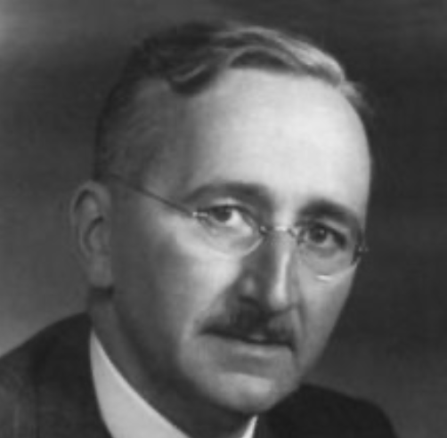
Hayek and Polanyi
Thumbnails on our first two:
Hayek:
Only the market economy can use society’s knowledge.
But the market economy cannot produce “social justice” and should not be asked to try—in fact, we need to recognize that all we can attain is freedom, and that will bring general prosperity, but that justice will be forever outside our reach
Polanyi:
The market economy turns land, labor, and finance into “fictitious commodities”
Society will have its revenge via a “double movement”

Slide 97
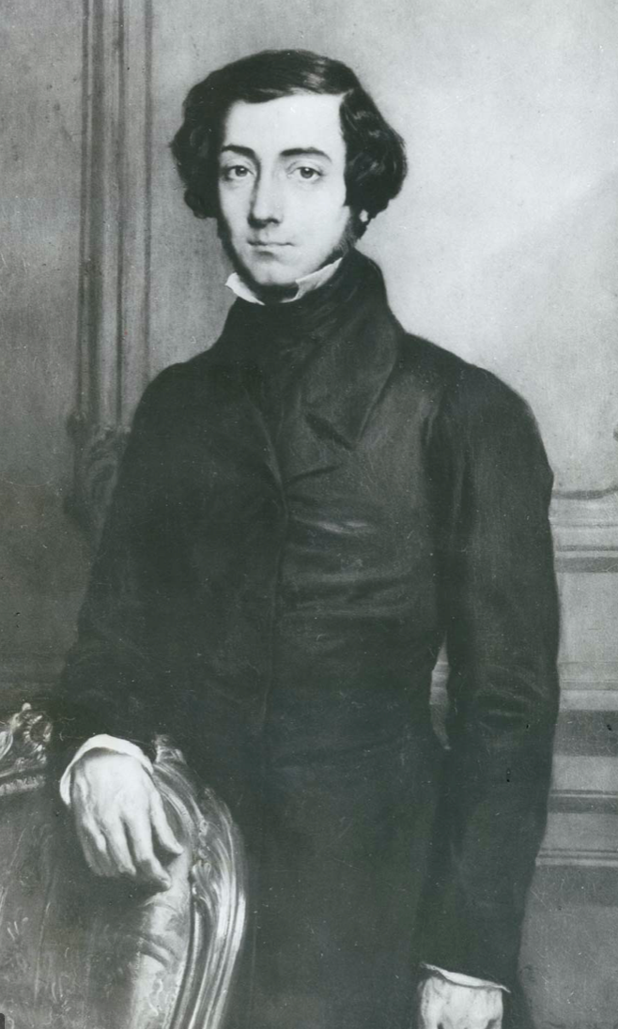
Plus Tocqueville
Toqueville on the rich as “elder brothers” in 1848:
“In the country all the landed proprietors, whatever their origin, antecedents, education or means, had come together, and seemed to form but one class: all former political hatred and rivalry of caste or fortune had disappeared from view. There was no more jealousy or pride displayed between the peasant and the squire, the nobleman and the commoner; instead, I found mutual confidence, reciprocal friendliness, and regard. Property had become, with all those who owned it, a sort of badge of fraternity. The wealthy were the elder, the less endowed the younger brothers; but all considered themselves members of one family, having the same interest in defending the common inheritance. As the French Revolution had infinitely increased the number of land-owners, the whole population seemed to belong to that vast family. I had never seen anything like it, nor had anyone in France within the memory of man…”
“The territorial aristocracy of past ages… [was] obliged… to come to the help of its servants and relieve their distress” no such reciprocal ties of obligation bound the aristocrats of manufactures to their workers: thus “the manufacturing aristocracy which we see rising before our eyes is one of the hardest that have appeared on the earth…”

Slide 98
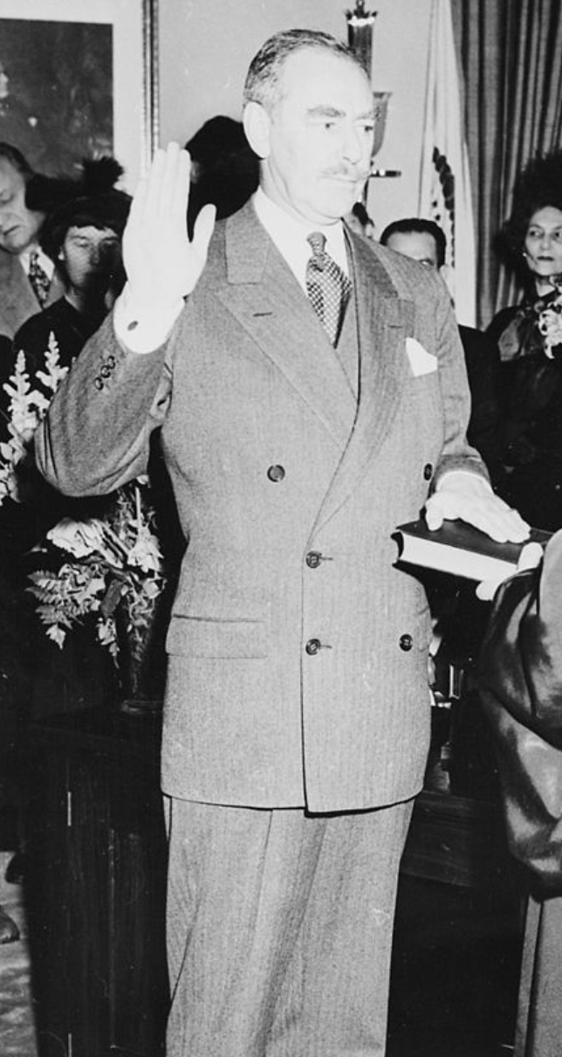
Plus Acheson
Dean Acheson, Secretary of State for Harry S Truman:
On the Republican Party as the party of wealth, enterprise, and opportunity:
“This business base of the Republican Party is stressed not in any spirit of criticism. The importance of business is an outstanding fact of American life. The achievements of business have been phenomenal. It is altogether appropriate that one of the major parties should represent its interests and its point of view…”
The subsequent transformation of the Republican Party from those who were going to become millionaires, or become even greater millionaires; to those who fear that they would lose it all…

Slide 99
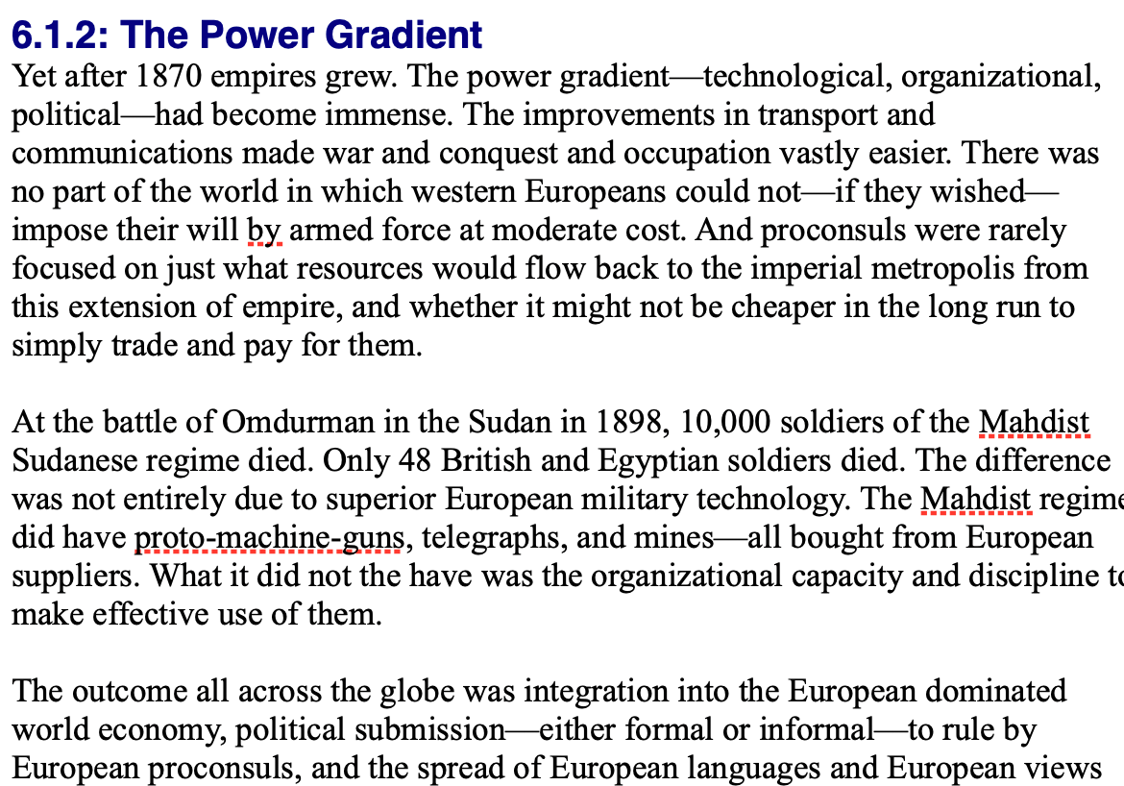
Review: Empire
By 1810 the tide of empire had been clearly ebbing…
But then things turned around: the power gradient:

Slide 100
To Your iClickers!
According to Eichengreen, graphing international capital flows and mobility since 1850 over time produces a graph that is:
V-shaped
U-shaped
W-shaped
An upward line
None of the above

Slide 101
To Your iClickers!
According to Eichengreen, the responsibilities of a pre-World War I central bank as steward of the global gold standard and also as lender-of-last-resort in domestic financial crises were:
in complete harmony
in irresolvable tension
for the most part manageable, before World War I at least, via fancy footwork and good luck
not understood
none of the above

Slide 102
To Your iClickers!
According to Eichengreen, the experience of being on the gold standard for North Atlantic economies in the 1870-1914 period was by and large a happy one, and the experience of countries at the world economy’s periphery was:
also by and large a happy one.
a mixed one.
a source of considerable tension, instability, and political upset.
once again, manageable with fancy footwork and a little good luck.
none of the above.

Slide 103
To Your iClickers!
In Eichengreen’s view, if World War I had somehow been avoided, would the global gold standard have remained stable in the 1920s and 1930s?
There are no guarantees, but probably yes.
There are no guarantees, but probably no.
Certainly not!
Certainly yes—unless several North Atlantic economies experienced a socialist revolution
None of the above.

Slide 104
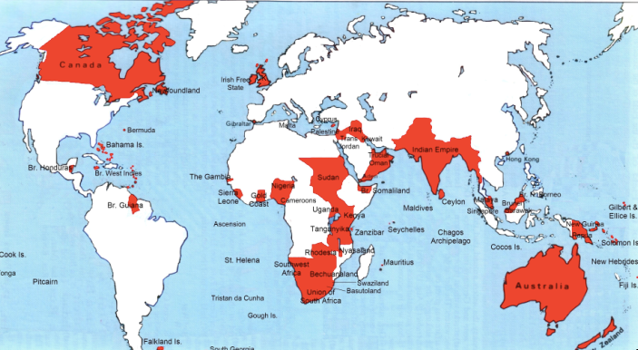
Empire

Slide 105
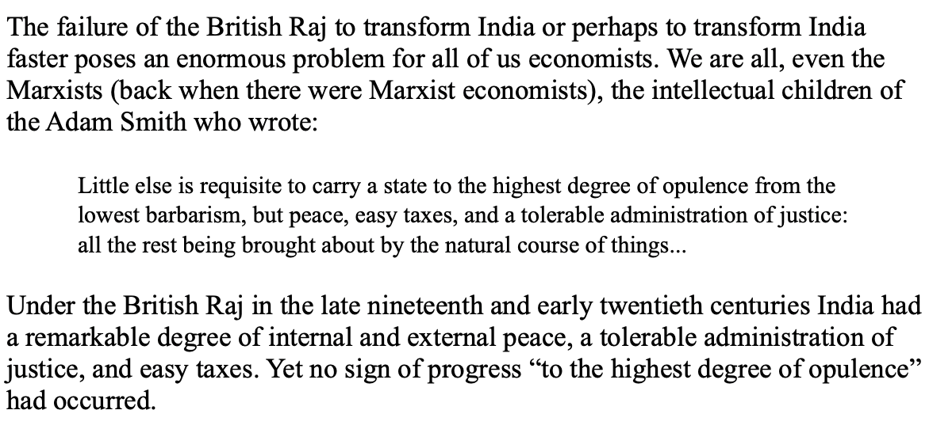
India
Why didn’t the British transform India into an industrial power?

Slide 106
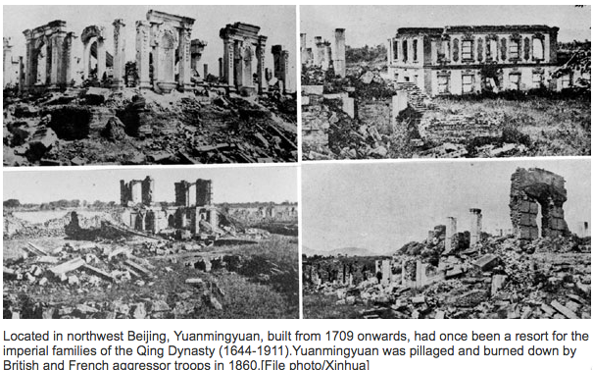
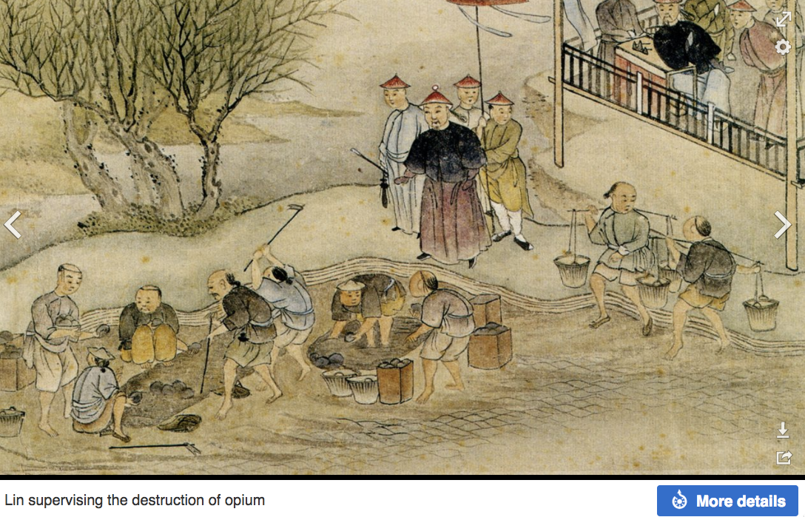
“Self-Strengthening”
The puzzle of China vs. Japan
Great Qing (大清)(1644-1912)
Wu Sangui (吳三桂)
The Rebellion of the Three Feudatories (三藩之亂)
Kangxi and Qianlong: “revere the emperor and expel the barbarians” is difficult to pursue when the emperor and his clan identify themselves as “barbarians”
Tai-Ping Rebellion (太平天國運動)
Cixi ( 慈禧太后)
Li Hongzhang (李鴻章)the Kai-Ping coal mine, Chang Yen-Mao, and Herbert Hoover

Slide 107
Formal Empires
There were, broadly, three views as to why European late-1800s empires rose to such domination, each of which with its own view of what was to be done to fix the situation:
One view is that of John Hobson: The major economic problem was the business cycle. Equipping the military needed to maintain the empire puts people to work. And an empire is a good source of consumers for the products of domestic factories. European governments that pursued empire, Hobson thought, were less likely to face economic distress and so more likely to continue in office.
A second view was that of Joseph Schumpeter: imperialism as the last gasp of military status aristocracy.
The third view was that empires were ordained by God—or at least morally required or desirable, for European powers had a civilizing mission. The Europeans were lucky enough to be the grownups, and it was the obligation of the grownups to civilize the world. But perhaps civilization is best spread by newspapers and books and merchants and engineers, rather than by alien proconsuls? Just a thought.

Slide 108
Informal Empires
But even where Britain (or France, or Germany, or Portugal, or Spain, or those who thought of themselves as descended from the conquistadores of Castile, or Anglo-Saxon settlers) did not rule, they reigned:
Britain seemed successful: playing by Britain’s rules seemed wise…
Britain was powerful: playing by Britain’s rules seemed likely to keep it from getting annoyed…
Britain was working very hard to make itself attractive—to make becoming a Briton-by-proxy of some sort straightforward and profitable in both money and cultural terms…
Britain was the first-mover hegemon: international cooperation was on its terms…

Slide 109
Catch Our Breath…
Comments?
Questions?

Slide 110
Review: Revolutions
“Petty Officer Lemmgen… arrived at the Ministry [of War]… found… Lieutenant HambuRger.... Lemmgen produced a typed document with the following text: ‘Comrades and Workers! The Ebert-Scheidemann government have made themselves impossible.... The undersigned Revolutionary Council has provisionally assumed power.’
“Lieutenant Hamburger inspected the document and became properly indignant. ‘But where are the signatures? Before I can comply with this order, you’ll have to go back and get it properly signed. Otherwise any little shorthand typist could declare the government deposed.’ Petty Officer Lemmgen... saw the logic…. So he and his men saluted... and made their way back to the Revolutionary Council to obtain the necessary signatures....
“But by the time he had obtained the signatures, Lemmgen had learned that the People’s Naval Division had declared itself neutral. So he did not return to the Ministry of War…”

Slide 111
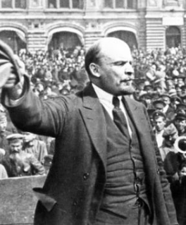
Lenin
A quick power grab…
Confidently expecting a German revolution, and then massive aid…
Brutal civil war
Kerenskyites
Reds
Whites
Nationalists
What was the revolutionary government to do?
Ludendorff’s German war economy…

Slide 112
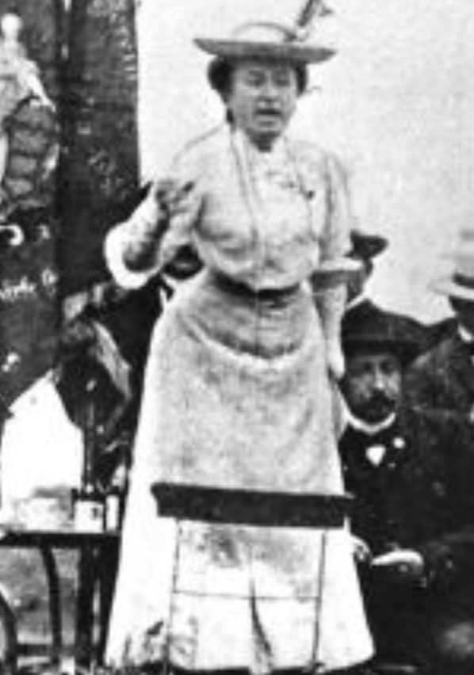
Red Rosa on Lenin
“Without general elections, without unrestricted freedom of press and assembly, without a free struggle of opinion, life dies out in every public institution…. Only the bureaucracy remains…. A few dozen party leaders of inexhaustible energy and boundless experience direct and rule….
“An elite of the working class is invited from time to time to meetings where they are to applaud the speeches of the leaders, and to approve proposed resolutions unanimously–at bottom, then, a clique affair…. Such conditions must inevitably cause a brutalization of public life: attempted assassinations, shooting of hostages, etc…
“Freedom only for the supporters of the government, only for the members of one party–however numerous they may be–is no freedom at all. Freedom is always and exclusively freedom for the one who thinks differently. Not because of any fanatical concept of “justice” but because all that is instructive, wholesome and purifying in political freedom depends on this essential characteristic, and its effectiveness vanishes when ‘freedom’ becomes a special privilege…

Slide 113

Review: The U.S.: The Roaring Twenties
The boom of the 1920s
Mass production—the flowering of the Second Industrial Revolution
“The business of America is business”
Structural changes in the 1920s…

Slide 114
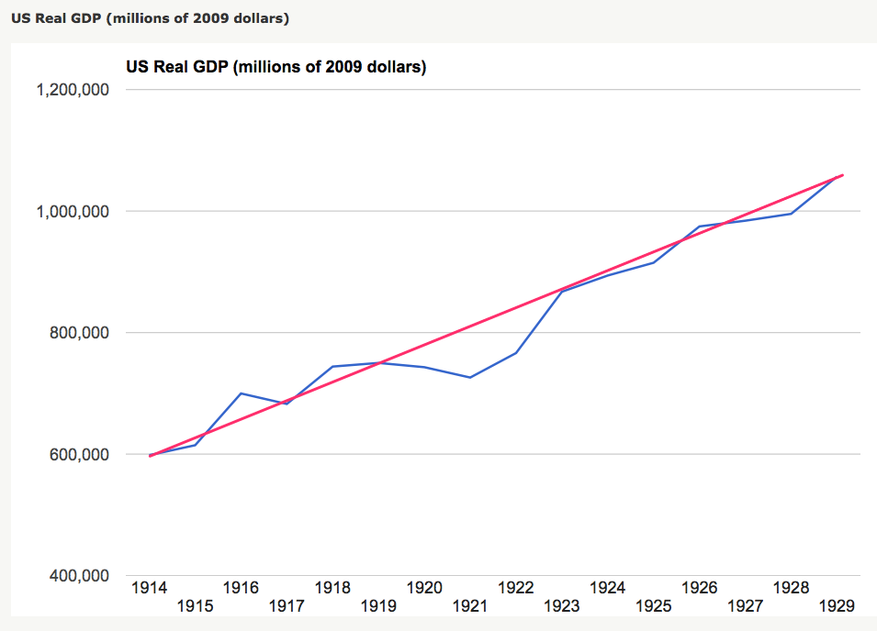
Structural Changes in the 1920s
Mass production—Henry Ford and the Model T
End of mass immigration—immigration restrictions of 1924
What do these do to the demand for construction, and construction workers?
The role of the stock market…
The role of the banking system…

Slide 115
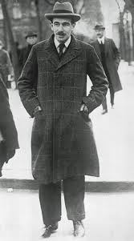
Review: To Your iClickers
John Maynard Keynes thought that the prosperity of the pre-WWI years was:
Natural and stable: a logical development out of human drives that went from strength to strength, and could only be overthrown by a very unlikely disaster.
Artificial and unstable, and based on a very complicated system in which, largely by chance, a lot happened to go right.
Natural but unstable, in that it was a logical development out of humanity’s trading nature but could be disturbed by other human drives—like tribalism, and the lust for domination.
Artificial but stable, as constructed by the greatest minds of the age, and only overthrown by a very unlikely disaster.
None of the above

Slide 116
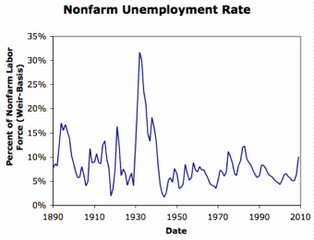
Review: Why the “Perfect Storm” of 1929-1933?
Previous Cycles:
1873—railroad
1884—railroad redux
1893—free silver
1904—Northern Securities
1907—gold drain to Britain
1914—disruption of the start of WWI
1920—deflation; return to “normalcy”
What brought previous downturns to a halt?
What made the Great Depression so great?

Slide 117
General Glut
How is it that there can be a "general glut" in which pretty much every produced commodity and the labor of workers are in excess supply, given that humans are far from satiated with production goods and given that one person's expenditure is another person's income?
Remember: you can take your income and use it either to buy things that are useful or to build up your stock of cash money. If there is excess demand for useful commodities, people can switch from producing whatever they were making to producing whatever is in short supply.
But the only way to build up your stock of cash is to try to cut your spending below your income. And since one person's spending is another person's income, that simply cannot be done in general.
If people in general try, the result is that spending and incomes fall economywide until they are both at such a low level that people de-prioritize building up their cash holdings.

Slide 118
What Had Ended Previous Downturns?
Previous Cycles:
1873—RR investment drops to zero
1884—RR investment drops to zero
1893—confidence that gold standard will be kept
1904—Theodore Roosevelt
1907—J.P. Morgan constitutes himself a pick-up central bank
1914—profits from European war demand WWI
1920—Federal Reserve reverses course

Slide 119
Interwar Gold Standard
The interwar gold standard caused, deepened, and definitely did nothing toward curing or ameliorating the Great Depression?
There is nothing worse than attempting to credibly commit to an incredible policy
The fear that the gold standard would break down caused people to want to hoard cash—to build up their cash holdings.
The fear that the gold standard would break down caused governments to be extremely unwilling to boost their economies' cash supplies—such boosts might, governments feared, undermine confidence that their country would stay on the gold standard.
Big depressions happen when the popular demand for cash outstrips the government's supply
The interwar gold standard was thus a powerful motivator and stage-setter pushing both people and governments into the patterns of behavior that produced the Great Depression

Slide 120
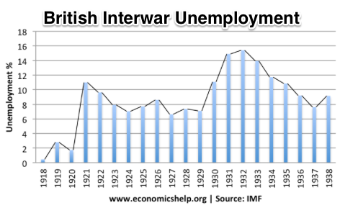
“Crying ‘Fire! Fire!’ in Noah’s Flood…”
France gold acquisition policy
American gold acquisition policy
The weakness of the gold-exchange standard—that people knew the gold standard could and would be abandoned
Labor-side pressure…
Nothing worse than an attempt to credibly commit to an incredible policy…
And then the belief that inflation was always just around the corner…

Slide 121
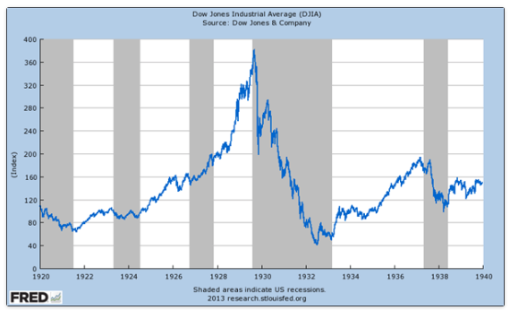
The Role of the Stock Market
Stock market doubles between the start of 1927 and late 1929
Positive-feedback margin trading
And a large number of people coming into the market who do not understand what is going on
Castles in the air
Prohibition?
Monetary policy?
Mass production?
The expectations shock produced

Slide 122
Why Was the Great Depression so Great?
John Maynard Keynes:
“When once the recovery has been started, the manner in which it feeds on itself and cumulates is obvious. But during the downward phase, when both fixed capital and stocks of materials are for the time being redundant and working-capital is being reduced, the schedule of the marginal efficiency of capital may fall so low that it can scarcely be corrected, so as to secure a satisfactory rate of new investment, by any practicable reduction in the rate of interest.
“Thus with markets organised and influenced as they are at present, the market estimation of the marginal efficiency of capital may suffer such enormously wide fluctuations that it cannot be sufficiently offset by corresponding fluctuations in the rate of interest. Moreover, the corresponding movements in the stock-market may, as we have seen above, depress the propensity to consume just when it is most needed. In conditions of laissez-faire the avoidance of wide fluctuations in employment may, therefore, prove impossible without a far-reaching change in the psychology of investment markets such as there is no reason to expect.
“I conclude that the duty of ordering the current volume of investment cannot safely be left in private hands….”

Slide 123
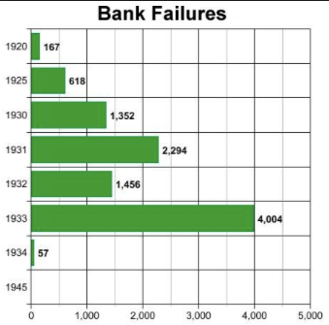
The Role of the Banking System
In the United States in the 1920s, about 600 banks failed a year—largely small rural banks
But banks set out to make riskier and riskier loans
Do they count on rescue from the Federal Reserve?
And when the Great Depression hits, bank failures rise to previously-unimaginable heights
Is there anything that could do more to boost the demand for or reduce the supply of cash?
And so call forth a general glut?
Lenders of “last resort”?

Slide 124
The Presumption Before the Great Depression
The presumption before the Great Depression that the government was not responsible for managing and curing the business cycle…
Two strands reinforced each other.
The first was the strength of the idea of laissez-faire: that government (protecting property and enforcing contracts aside) was overwhelmingly a problem and not a solution. As John Maynard Keynes wrote in his essay The End of Laissez-Faire, a powerful drive behind that was: “the corruption and incompetence of eighteenth-century government…. Almost everything which the State did in the eighteenth century in excess of its minimum functions was, or seemed, injurious or unsuccessful. [And] on the other hand, material progress between 1750 and 1850 came from individual initiative…”
The second was social Darwinism—that, in the words of steelmaster Andrew Carnegie, the second-richest man in America circa 1905 and a man who gave away his entire fortune: “The price we pay for [our civilization]... is, no doubt, great.... The employer of thousands is forced into the strictest economies... [in] the rates paid to labor.... The law of competition... is here; we cannot evade it; no substitutes for it have been found; and while the law may be sometimes hard for the individual, it is best for the race, because it insures the survival of the fittest in every department..."
The result was a dominant belief—at least among the rich and powerful—that:
The market giveth, the market taketh away: blessed be the name of the market.

Slide 125
The Hoover Administration’s Reaction to the Great Depression
The 1929-1933 Hoover administration believed that little could be done.
That the only good things that could be done were to (a) repeatedly state that "prosperity is just around the corner" and (b) try to cut federal government spending and raise taxes in order to restore confidence and scotch the fear of high inflation.
As economist R.G. Hawtrey wrote, to worry about inflation in the midst of the Great Depression was like "crying 'FIRE! FIRE!' in Noah's Flood..."
Herbert Hoover himself wrote afterwards about how his administration had been dominated by the "'leave-it-alone liquidationists' headed by Secretary of the Treasury Mellon, [who] felt that government must keep its hands off and let the slump liquidate itself. Mr. Mellon had only one formula:
'Liquidate labor, liquidate stocks, liquidate the farmers, liquidate real estate'. He held that even panic was not altogether a bad thing. He said: 'It will purge the rottenness out of the system. High costs of living and high living will come down. People will work harder, live a more moral life. Values will be adjusted, and enterprising people will pick up the wrecks from less competent people'…"
Hoover went on to state that he did not share this view…
That raises lots of questions about how his administration worked…

Slide 126
To Your iClickers
The largest automobile manufacturer in the world in 1928 was:
Toyota
Daimler-Benz
Peugeot
Ford
General Motors

Slide 127
To Your iClickers…
Worldwide, the Great Depression was was:
In relative terms, equalled by the Cleveland Depression of 1893-6
In relative terms, smaller than the depression that followed the Crash of 1873
In relative terms, equalled by the Great Recession of 2008-2020
In relative terms, by far the largest depression ever
None of the above

Slide 128
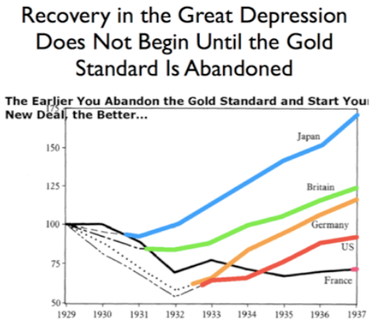
Review: New Deals
Japan: Takahashi Korekiyo
moved early to maintain full employment
Britain: MacDonald-Snowden-Baldwin
Forced off…
Germany: Adolf Hitler
Succeeds Bruening
America: Franklin Delano Roosevelt
Succeeds Herbert Hoover
France: Leon Blum

Slide 129
Recovery
Japan recovered the fastest,
Germany second,
Britain third,
The U.S. fourth,
France last.
By-and-large, the sooner you abandon the gold standard, expand the money supply, and undertake a "New Deal" to boost government spending, the better…

Slide 130
The Polanyian Perplex
People believe that the rights they have are broader and deeper than simply property rights, but the market economy disagrees.
Thus either governments will find a way to guarantee their populations these extra rights to community stability, general prosperity, and full employment, or society will react somehow against the liberal market-oriented political-economic system.
“Fictitious commodities”:
Land
Labor
Finance
Society’s “double movement”

Slide 131
The Permanent Problem of the Human Race
John Maynard Keynes thought that the economic problem would not be the "major problem of the human race"
By the end of the twentieth century the human race would be so rich that people would be practically satiated with commodities.
Thus the "economic problem" of how to economize and be efficient, and allocate scarce means among alternative uses, was not the permanent problem of the human race.
Instead, "for the first time since his creation man will be faced with his real, his permanent problem-how to use his freedom from pressing economic cares, how to occupy the leisure, which science and compound interest will have won for him, to live wisely and agreeably and well.... It will be those peoples, who can keep alive, and cultivate into a fuller perfection, the art of life itself and do not sell themselves for the means of life, who will be able to enjoy the abundance when it comes..."
Yet Keynes was not sure that having to confront this problem would be a net plus for humanity: "Will this be a benefit? If one believes at all in the real values of life, the prospect at least opens up the possibility of benefit. Yet I think with dread of the readjustment of the habits and instincts of the ordinary man, bred into him for countless generations, which he may be asked to discard within a few decades..."

Slide 132
Digression: How to Study
Will I ask you about Jan Christian Smuts? About the prayer (and theology) of the Grigua?
No…
Themes and concepts…
But you need narratives and stories to hang onto them…
And our brains are very good at deep-sixing useless information
Andy Matuschak: Why Books Don’t Work <https://andymatuschak.org/books/>:
“Picture some serious non-fiction tomes. The Selfish Gene; Thinking, Fast and Slow; Guns, Germs, and Steel; etc.
“Have you ever had a book like this—one you’d read—come up in conversation, only to discover that you’d absorbed what amounts to a few sentences? I’ll be honest: it happens to me regularly. Often things go well at first. I’ll feel I can sketch the basic claims, paint the surface; but when someone asks a basic probing question, the edifice instantly collapses. Sometimes it’s a memory issue: I simply can’t recall the relevant details. But just as often, as I grasp about, I’ll realize I had never really understood the idea in question, though I’d certainly thought I understood when I read the book. Indeed, I’ll realize that I had barely noticed how little I’d absorbed until that very moment. I know I’m not alone here…

Slide 133
Skipped Topic: Pre-1914 Political Economy: Over in Europe
The June Days of 1848 in Paris:
Tocqueville:
“The insurrection of June [1848]... class against class... a blind and rude, but powerful, effort on the part of the workmen to escape from the necessities of their condition, which had been depicted to them as one of unlawful oppression…. The closing of the national workshops… occasioned the rising…”
“Thousands… hastening to our aid from every part of France.... Thanks to the railroads, some had already come from fifty leagues’ distance... every class of society... peasants... shopkeepers... landlords and nobles all mingled together... they rushed into Paris with unequalled ardour: a spectacle as strange and unprecedented in our revolutionary annals.... The insurgents received no reinforcements, whereas we had all France for reserves…”

Slide 134
French Politics
Régimes stability is not on the menu:
the terrorist dictatorship of the Jacobins (the mainspring of popular government… amid revolution it is at once virtue and terror: virtue, without which terror is fatal; terror, without which virtue is impotent…)
a corrupt and gerrymandered 5-man executive of the Directory, defended on October 5, 1795 by the “whiff of grapeshot” of Napoleon Bonaparte and Joachim Murat, that managed to generate the first modern hyperinflation, defended itself against a royalist coup plotted by two of its five members (Barthelemy and Carnot) and its most successful general (Pichegru), and was then overthrown by the same Napoleon in 1799.
a dictatorship, with Napoleon Bonaparte as “First Consul”, until 1804.
an empire, with Napoleon Bonaparte as Emperor of the French, until suppressed by the other European powers in 1815.
a restored Bourbon monarchy, with first Louis XVIII and then Charles X, until 1830.
an alternative Orleanist monarchy, with King Louis-Philippes as the king-citizen, overthrown in 1848.
a second republic, overthrown by its own president, Napoleon’s nephew Louis Napoleon, which collapsed under pressure of military defeat in 1870.
a socialist commune, in Paris at least.
a third republic, which suppressed the commune—but promptly chose a royalist Marshal MacMahon, as president.
a failed attempt by third republic president Marshal MacMahon to replace himself by a King Henry V.
a failed attempt by the ex-Minister of War Georges Boulanger to seize power for his RRR movement: Revanche, Révision, Restauration (revenge on Germany, revision of the constitution, restoration of the monarchy).

Slide 135
Left-Wing Normal European Politics I
Disjunction between policies and rhetoric:
The Socialist Party of Germany’s Erfurt and Gotha programs seek things like: holidays for elections, two-year legislative terms, the right to bear arms, equal rights for women, the prohibition of spending public funds for religious purposes, free public schools and colleges, free medical care including midwifery, an eight-hour working day, no child labor under 14, a 36-hour minimum weekend, an occupational safety and health administration…

Slide 136
Left-Wing Normal European Politics II
Disjunction between policies and rhetoric:
But also: “By every lawful means to bring about a free state and a socialistic society, to effect the destruction of the iron law of wages by doing away with the system of wage labor.” And they sought: “the transformation of the capitalist private ownership of the means of production—land and soil, pits and mines, raw materials, tools, machines, means of transportation—into social property and the transformation of the production of goods into socialist production carried on by and for society.” And they believed: “This… emancipation… of the entire human race…. But it can only be the work of the working class, because all other classes… have as their common goal the preservation of the foundations of contemporary society.”

Slide 137
Center and Right-Wing Normal European Politics
The touchstone was “fairness”: it was not fair that those who did not work hard and did not play by the rules got lots of good things:
Those who did not play by the rules could be on either end of the wealth-and-power spectrum:
Parasitic aristocrats and cruel plutocrats
Those poor who wanted something for nothing, or got above their station
A middle-class, social order movement
Focus voters’ attention on the disruptive utopian aspirations of the left, and electoral coalitions could be preserved…
Preserve as much as possible of old orders of hierarchy in changing times:
Reform to preserve; change so things could stay the same
Find new reasons why hierarchy is good: social darwinism

Slide 138
Magnifying Non-Economic Cleavages Had Dangers
Society under threat not by economic inequality but by social disorder—or aliens—or other nations. Plus:
A right-wing landed and bureaucratic upper class that had, by and large, lost its social role.
A belief by politicians anxious to paper over class divisions that they could be papered over with national or ethnic unity.
A growing social-darwinist current that struggle was good, and the victors should be rewarded
Even or especially military struggle by peoples-in-arms, over not what language a province would be administered in but who would live there
These stored up trouble as 1914 approached.
In 1919 John Maynard Keynes was to write, bitterly, that he, his peers, and his elders had regarded:
“the projects and politics of militarism and imperialism, of racial and cultural rivalries, of monopolies, restrictions, and exclusion, which were to play the serpent to this paradise… [as] little more than the amusements of his daily newspaper…”

Slide 139
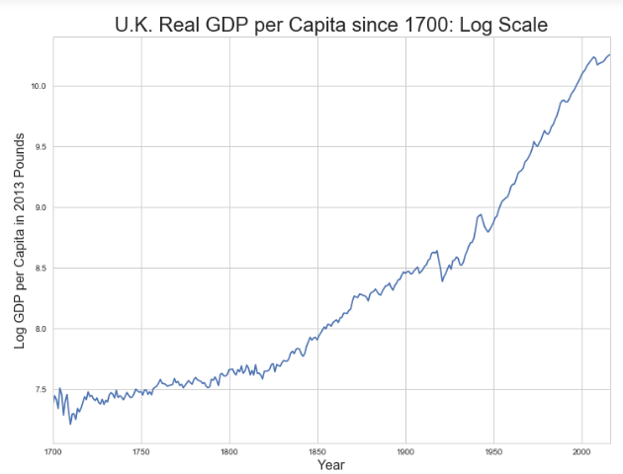
Skipped Topic: Passing the Baton: From Britain to America
The Industrial Revolution took place in Britain
The standard explanation four or five largely independent strands coming together.:
Limited government, security of property, and freedom of contract
Science and the technological tradition of sustained inquiry
Victory in the wars of the Commercial Revolution era
Machinery making, "tinkering", and "gadgets"—primarily made out of metal.
Coal in Britain—the only thing that made a steam engine potentially profitable.
Plus high elasticity of demand for leading-sector products…
http://bradford-delong.com brad.delong@gmail.com

Slide 140
iClickers: Why Breaktrhrough?
The principal reason that the Industrial Revolution took place in late eighteenth century Britain (rather than in Sung China, or Abbasid Baghdad, or Antonine Dynasty Rome, or during the Hellenistic Age) is:
A lack of human numbers thinking about problems of production
A lack of good means of communication—e.g. printing—for diffusing information about how to solve problems of production
A lack of experience using coal as an energy source
A lack of the incentive created by high real wages leading to a strong desire to make labor more productive
None of the above/not enough information
http://bradford-delong.com brad.delong@gmail.com

Slide 141
iClicker: Why Passing the Baton
The principal reason that the twentieth century was an American rather than a second British century was:
The United States’s aggressive and enthusiastic welcome of immigrants
The United States’s focus on broad-based technical education
The United States’s extraordinary abundance of natural resources driving high real wages and enormous incentives to build machines to manipulate matter
A U.S. government that took industrial development as a key policy goal, rather than being comfortable with laissez-faire
None of the above/not enough information
http://bradford-delong.com brad.delong@gmail.com

Slide 142
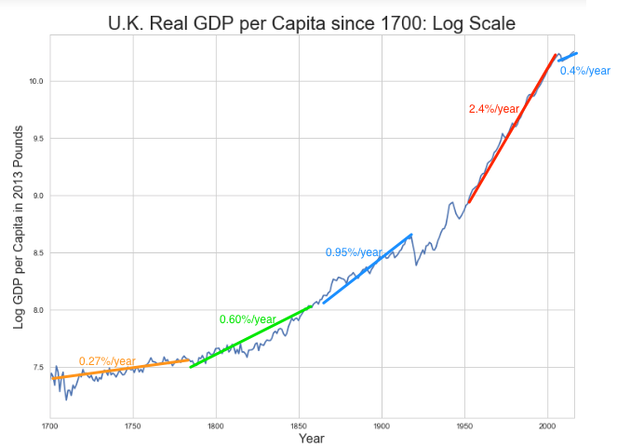
British Productivity Growth Acceleration
http://bradford-delong.com brad.delong@gmail.com

Slide 143
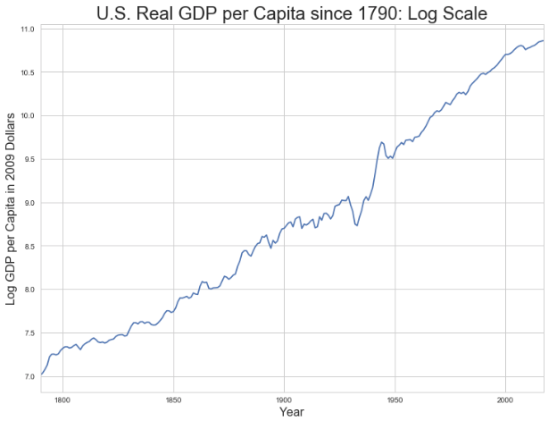
But Even in the First Half of the Nineteenth Century the U.S. Was Outpacing Britain in Growth…
Even in the first half of the nineteenth century—the period in which the British Industrial Revolution made it the wonder of the world—economic growth in the United States was proceeding faster than in Britain.
While British real GDP per capita was increasing at less than 0.6 percent per year
American was growing at a hair over one percent per year.
And a significantly larger share of GDP was going to the white working class in the United States, in the north at least:
The extraordinary abundance of land and the possibility of "lighting out for the territory", in the words of American author Mark Twain, gave even workers without property or notably scarce skills substantial economic bargaining power.
http://bradford-delong.com brad.delong@gmail.com

Slide 144
And Starting in the Late Nineteenth Century
Second Industrial Revolution…
Why the U.S. and Germany, and not Britain?
Immigration and Population
Was resource scarcity no longer a factor?
Was the differential in the growth rate h of the stock of useful economic knowledge even greater than the differential in the growth rate g of the efficiency-of-labor?
http://bradford-delong.com brad.delong@gmail.com

Slide 145
Phases of American Growth
1.0% per year in GDP per capita from 1760-1860: resource abundance
1.6% per year in GDP per capita from 1860-1929:
“Great traverse”: K/Y ratio up from 2.5 to 4
Half of it an increase in savings rates
Half of it a fall in the price of capital goods
2.5% per year in GDP per capita from 1929-1973
“Fordism”
Expected further acceleration: it did not happen
Post-1973
Productivity slowdown 1973-1995 (environment, oil, baby boom, feminism)
“New economy” 1995-2006
Post-2006 collapse of growth
http://bradford-delong.com brad.delong@gmail.com

Slide 146

American Productivity Growth Acceleration
http://bradford-delong.com brad.delong@gmail.com

Slide 147

Early Nineteenth Century: Westward Expansion
Westward expansion
The “American System”
Abundant natural resources
Very high real wages
Focus on raising labor productivity
Hence fast efficiency-of-labor growth
Britain, by contrast, focused on economizing on (non-coal) raw materials
http://bradford-delong.com brad.delong@gmail.com

Slide 148
The Importance of Resources 1760-1860
Major westward expansion and "Amerindian removal”
The century 1760 to 1860 before the Civil War.
We have U.S. output-per-worker growth then at about 1.0% per year…
…in contrast to British output-per-worker growth at about 0.5% per year.
We have the U.S. population and labor force growing at 2.5% per year…
…from 2.5 to 30 million.
http://bradford-delong.com brad.delong@gmail.com

Slide 149


The Importance of Resources 1760-1860
Recall our basic Solow Model:
http://bradford-delong.com brad.delong@gmail.com

Slide 150

The Importance of Resources 1760-1860
Recall our basic Solow Model:
Assume K/Y constant, so the growth rate g of the efficiency of labor and the growth rate of output-per-worker are the same:
http://bradford-delong.com brad.delong@gmail.com

Slide 151
The Importance of Resources 1760-1860
Recall our basic Solow Model:
Assume K/Y constant, so the growth rate g of the efficiency of labor and the growth rate of output-per-worker are the same:
http://bradford-delong.com brad.delong@gmail.com

Slide 152
The Importance of Resources 1760-1860
Recall our basic Solow Model:
Assume K/Y constant, so the growth rate g of the efficiency of labor and the growth rate of output-per-worker are the same:
Let’s, last, fit this to history in the century before the 1860 election of President Abraham Lincoln and the ensuing American Civil War:
http://bradford-delong.com brad.delong@gmail.com

Slide 153

The Importance of Resources 1760-1860
Recall our basic Solow Model:
Assume K/Y constant, so the growth rate g of the efficiency of labor and the growth rate of output-per-worker are the same:
Let’s, last, fit this to history in the century before the 1860 election of President Abraham Lincoln and the ensuing American Civil War:
http://bradford-delong.com brad.delong@gmail.com

Slide 154

Westward Expansion
http://bradford-delong.com brad.delong@gmail.com

Slide 155

The Importance of Resources 1760-1860
We have two parameters left: γ and h, the weight of ideas in efficiency-of-labor growth and the rate of growth of the stock of useful ideas for the economy in American heads, respectively:
http://bradford-delong.com brad.delong@gmail.com

Slide 156

The Importance of Resources 1760-1860
We have two parameters left: γ and h, the weight of ideas in efficiency-of-labor growth and the rate of growth of the stock of useful ideas for the economy in American heads, respectively:
http://bradford-delong.com brad.delong@gmail.com

Slide 157
The Importance of Resources 1760-1860
Thus if γ→∞ then h→0.010
http://bradford-delong.com brad.delong@gmail.com

Slide 158
The Importance of Resources 1760-1860
Thus if γ→∞ then h=0.010
Thus if γ=3.0 then h=0.00667
http://bradford-delong.com brad.delong@gmail.com

Slide 159
The Importance of Resources 1760-1860
Thus if γ→∞ then h=0.010
Thus if γ=3.0 then h=0.00667
Thus if γ=1.0 then h=0.00
http://bradford-delong.com brad.delong@gmail.com

Slide 160
The Importance of Resources 1760-1860
Thus if γ→∞ then h=0.010
Thus if γ=3.0 then h=0.00667
Thus if γ=1.0 then h=0.00
Looking across the Atlantic Ocean to Great Britain, we see that over there it is indeed the case that h=0.005 from 1760 to 1860. Faster growth of h in America due to some catchup with the world's first and leading industrial nation seems likely. So γ=3.0 has some claim to be the most likely value…
http://bradford-delong.com brad.delong@gmail.com

Slide 161
A Counterfactual
The Royal Proclamation of October 1763:
Our Royal Will and Pleasure… no... Governor or Commander in Chief in... our... Colonies or Plantations in America do... grant Warrants of Survey, or pass Patents for any Lands beyond the Heads or Sources of any of the Rivers which fall into the Atlantic Ocean from the West and North West, or upon any Lands whatever, which, not having been ceded to or purchased by Us as aforesaid, are reserved to the said Indians, or any of them...
http://bradford-delong.com brad.delong@gmail.com

Slide 162

What If This Royal Proclamation Had Stuck?
What if ρ=0?
If γ → ∞ and h=0.010 then g=0.01
If γ=3.0 and h=0.00667 then g=−0.00125
If γ=1.5 and h=0.000 then g=−0.01
http://bradford-delong.com brad.delong@gmail.com

Slide 163
What If This Royal Proclamation Had Stuck?
What if ρ=0?
If γ → ∞ and h=0.010 then g=0.01
If γ=3.0 and h=0.00667 then g=−0.00125
If γ=1.5 and h=0.000 then g=−0.01
An America penned behind the Appalachians would probably have seen its living standards and productivity levels not growing at 1% per year from 1760 to 1860 but shrinking.
For γ=3.0, living standards and productivity levels would have shrunk at a pace of -0.125% per year
http://bradford-delong.com brad.delong@gmail.com

Slide 164
What If This Royal Proclamation Had Stuck?
What if ρ=0?
Of course, a poorer America would probably have seen fewer immigrants.
But it might not have seen that many fewer immigrants.
It would no longer have been quite as attractive to move from Britain to America over 1760 to 1860.
But it still would have been very attractive to move from France, Germany, Scotland—or most of all from Potato Blight-ridden Ireland...
In what other ways might this counterfactual alternate-history "little America" would likely have been different in 1860 than America actually was?
http://bradford-delong.com brad.delong@gmail.com

Slide 165

“Trail of Tears’
http://bradford-delong.com brad.delong@gmail.com

Slide 166
A large chunk of America's pre-1860 visible growing prosperity was based not just on African-American slavery, but also on "Amerindian removal"
http://bradford-delong.com brad.delong@gmail.com

Slide 167
Catch Our Breath…
Ask me two questions…
Make two comments…

Slide 168

Late Nineteenth-Early Twentieth Century: “Great Traverse”
Invention of the industrial research lab
First globalization
Technologies of Second Industrial Revolution
Economies of scale and mass production
Falling price of capital goods
Greater savings effort
Plus mass immigration
Rapidly rising inequality
Or was it? Emancipation…
http://bradford-delong.com brad.delong@gmail.com

Slide 169
Capital Deepening
Lowered deprecation rate δ
From 5% to 3% per year
http://bradford-delong.com brad.delong@gmail.com

Slide 170
Capital Deepening
Lowered deprecation rate δ
From 5% to 3% per year
Increased savings rate s
Capital-output ratio goes from 2.5 to 4 across 70 years
http://bradford-delong.com brad.delong@gmail.com

Slide 171
Capital Deepening
Lowered deprecation rate δ
From 5% to 3% per year
Increased savings rate s
Capital-output ratio goes from 2.5 to 4 across 70 years
with an α=1, output-per-worker proportional to the capital-output ratio
ln(4/2.5)/70 = 0.007
g = 0.9%/year
http://bradford-delong.com brad.delong@gmail.com

Slide 172
Capital Deepening
Capital-output ratio goes from 2.5 to 4 across 70 years
with an α=1, output-per-worker proportional to the capital-output ratio
ln(4/2.5)/70 = 0.007
g = 0.9%/year
Second Industrial Revolution
Large managerial corporation
Large-scale investment banking
Industrial research lab
Continent-wide market
Globalization
http://bradford-delong.com brad.delong@gmail.com

Slide 173

Mid Twentieth Century: Drive to High Mass Consumption
DARPA, etc.: two heads are better than one
“Fordist” oligopolies
Second globalization
Keynesian stabilization policies
Falling and then low inequality
For white guys…
http://bradford-delong.com brad.delong@gmail.com

Slide 174
Mid Twentieth Century: Drive to High Mass Consumption
DARPA, etc.: two heads are better than one
“Fordist” oligopolies
Second globalization
Keynesian stabilization policies
Falling and then low inequality
For white guys…
http://bradford-delong.com brad.delong@gmail.com

Slide 175
Catch Our Breath…
Ask me two questions…
Make two comments…

Slide 176
Notes

